Slide 1
carte oxygene… globale

Slide 2
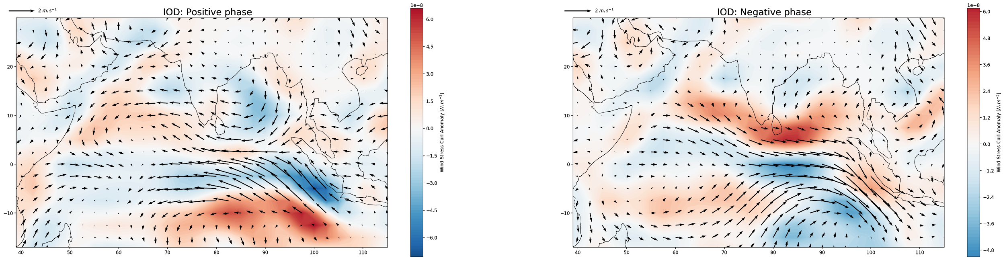
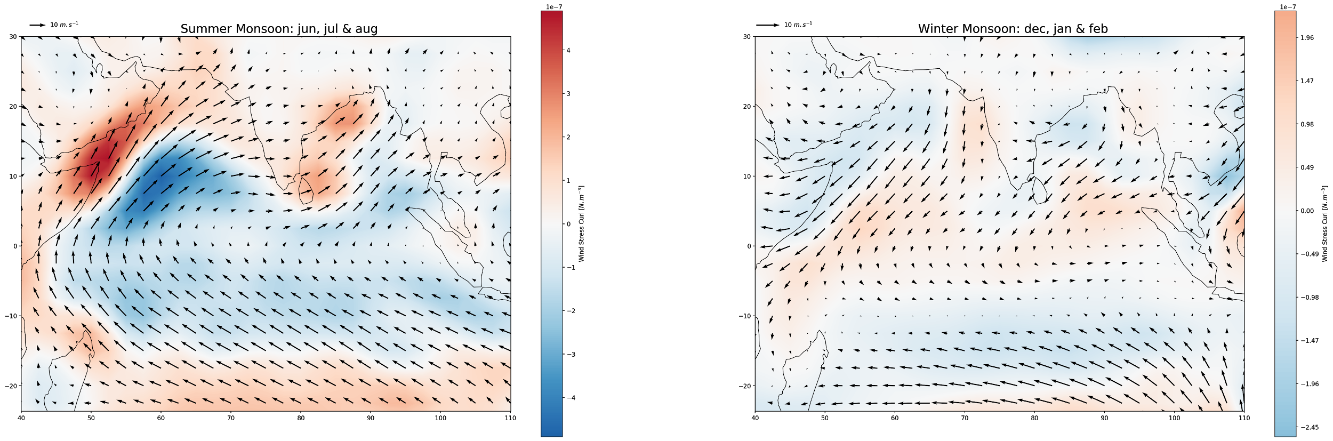
1).Climatologie de l’océan Indien: vent
a)
cartes mousson SST, SSS.
carte SST IOD + boite de l’indice DMI
a)
b)
b)
Composite of the wind stress curl anomaly (color) and wind speed (vector) calculated for the positive [a] (DMI>std(DMI)) and negative [b] (DMI<-std(DMI)) IOD phases from monthly averages of zonal and meridional wind speeds from NCEP reanalyses.
Wind stress curl composite (color) and wind speed (vector) calculated for summer [a] (June, July and August) and winter [b] (December, January and February) monsoons from monthly means of zonal and meridional wind speeds from NCEP reanalyses.

Slide 3
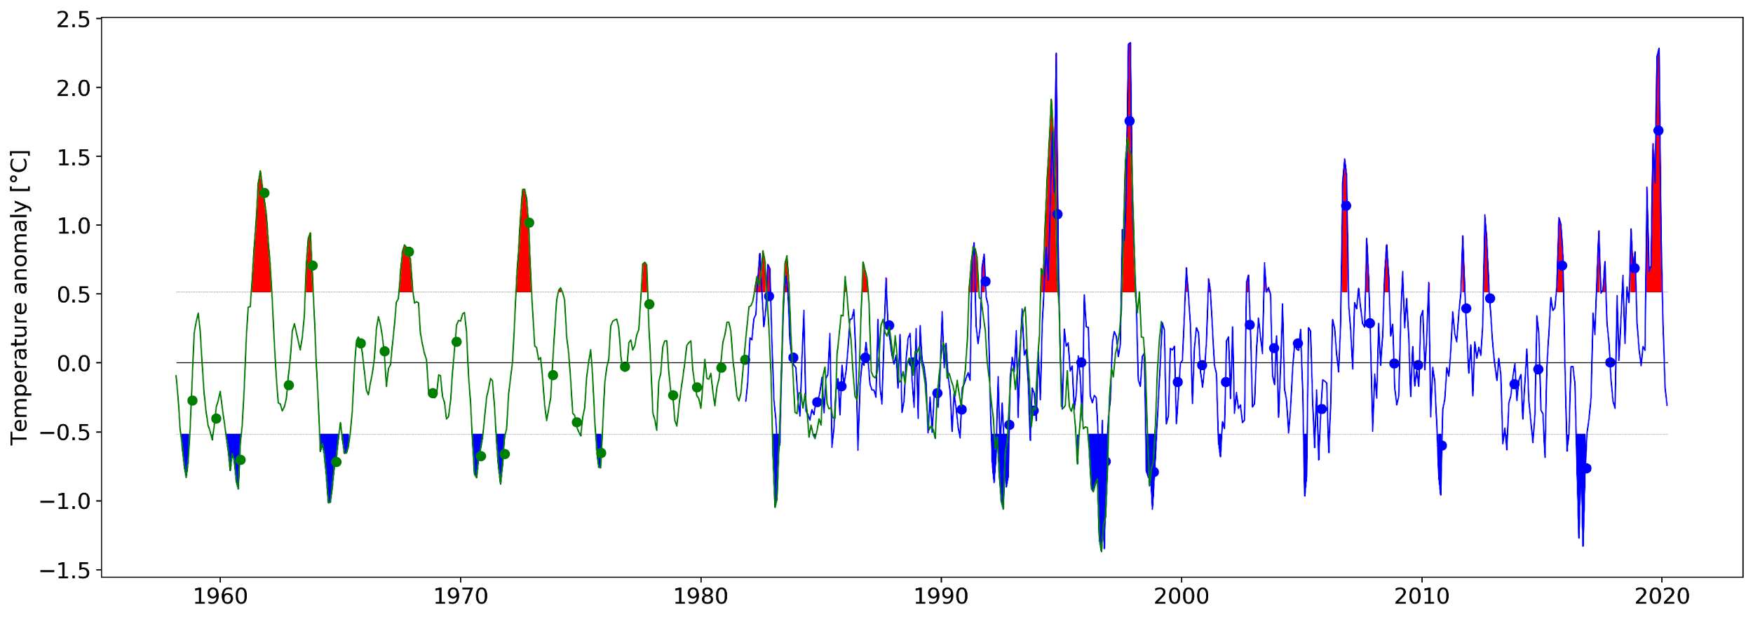
1). IOD et DMI
DMI = WTIO - SETIO
Bon légende à revoir ...
Monthly dipole mode index (DMI) from Saji et al (1999) for 1958-1999 (green) and from NOAA XXX for 1982-2020 (blue). Positive (red) and negative (bleu) IOD phases are defined by +/- one standard deviation in the DMI index. Dots correspond to the October-November average. The older time series is weighted to have the same standard deviation as the more recent one over the common measurement period (1982-1999).
move to methods.
The two time series are obtained by calculating the difference between the WTIO and SETIO indices.
https://stateoftheocean.osmc.noaa.gov/sur/ind/dmi.php.

Slide 4
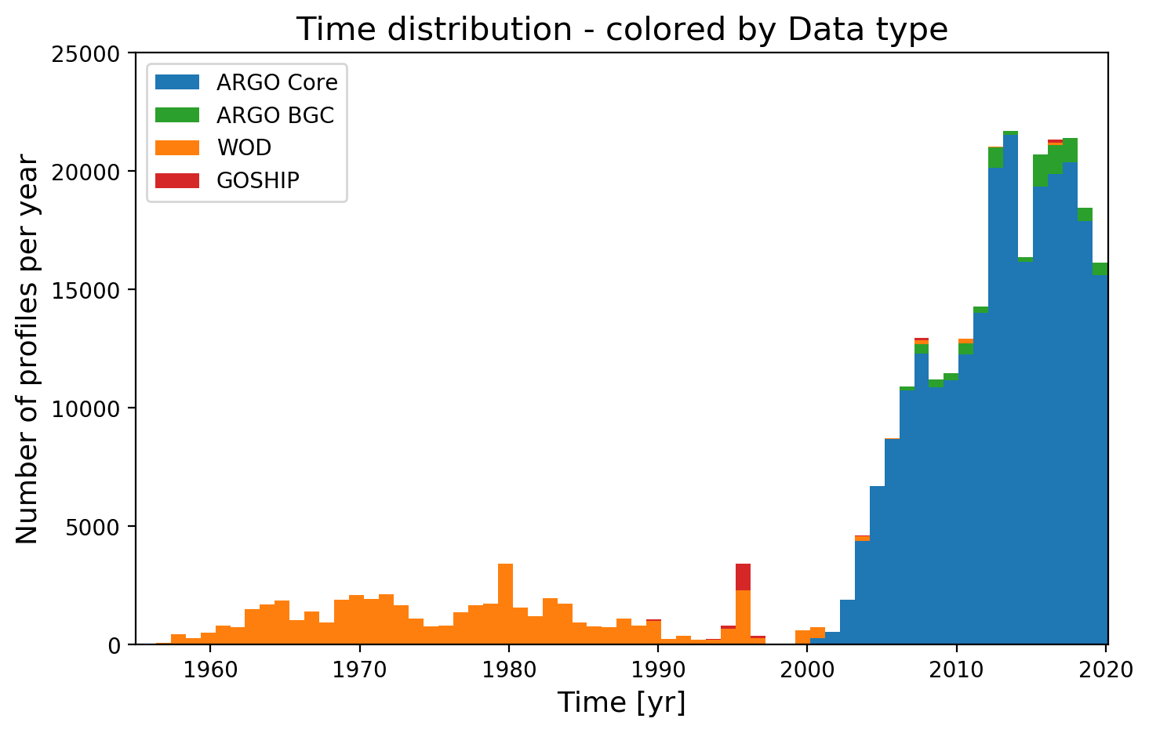
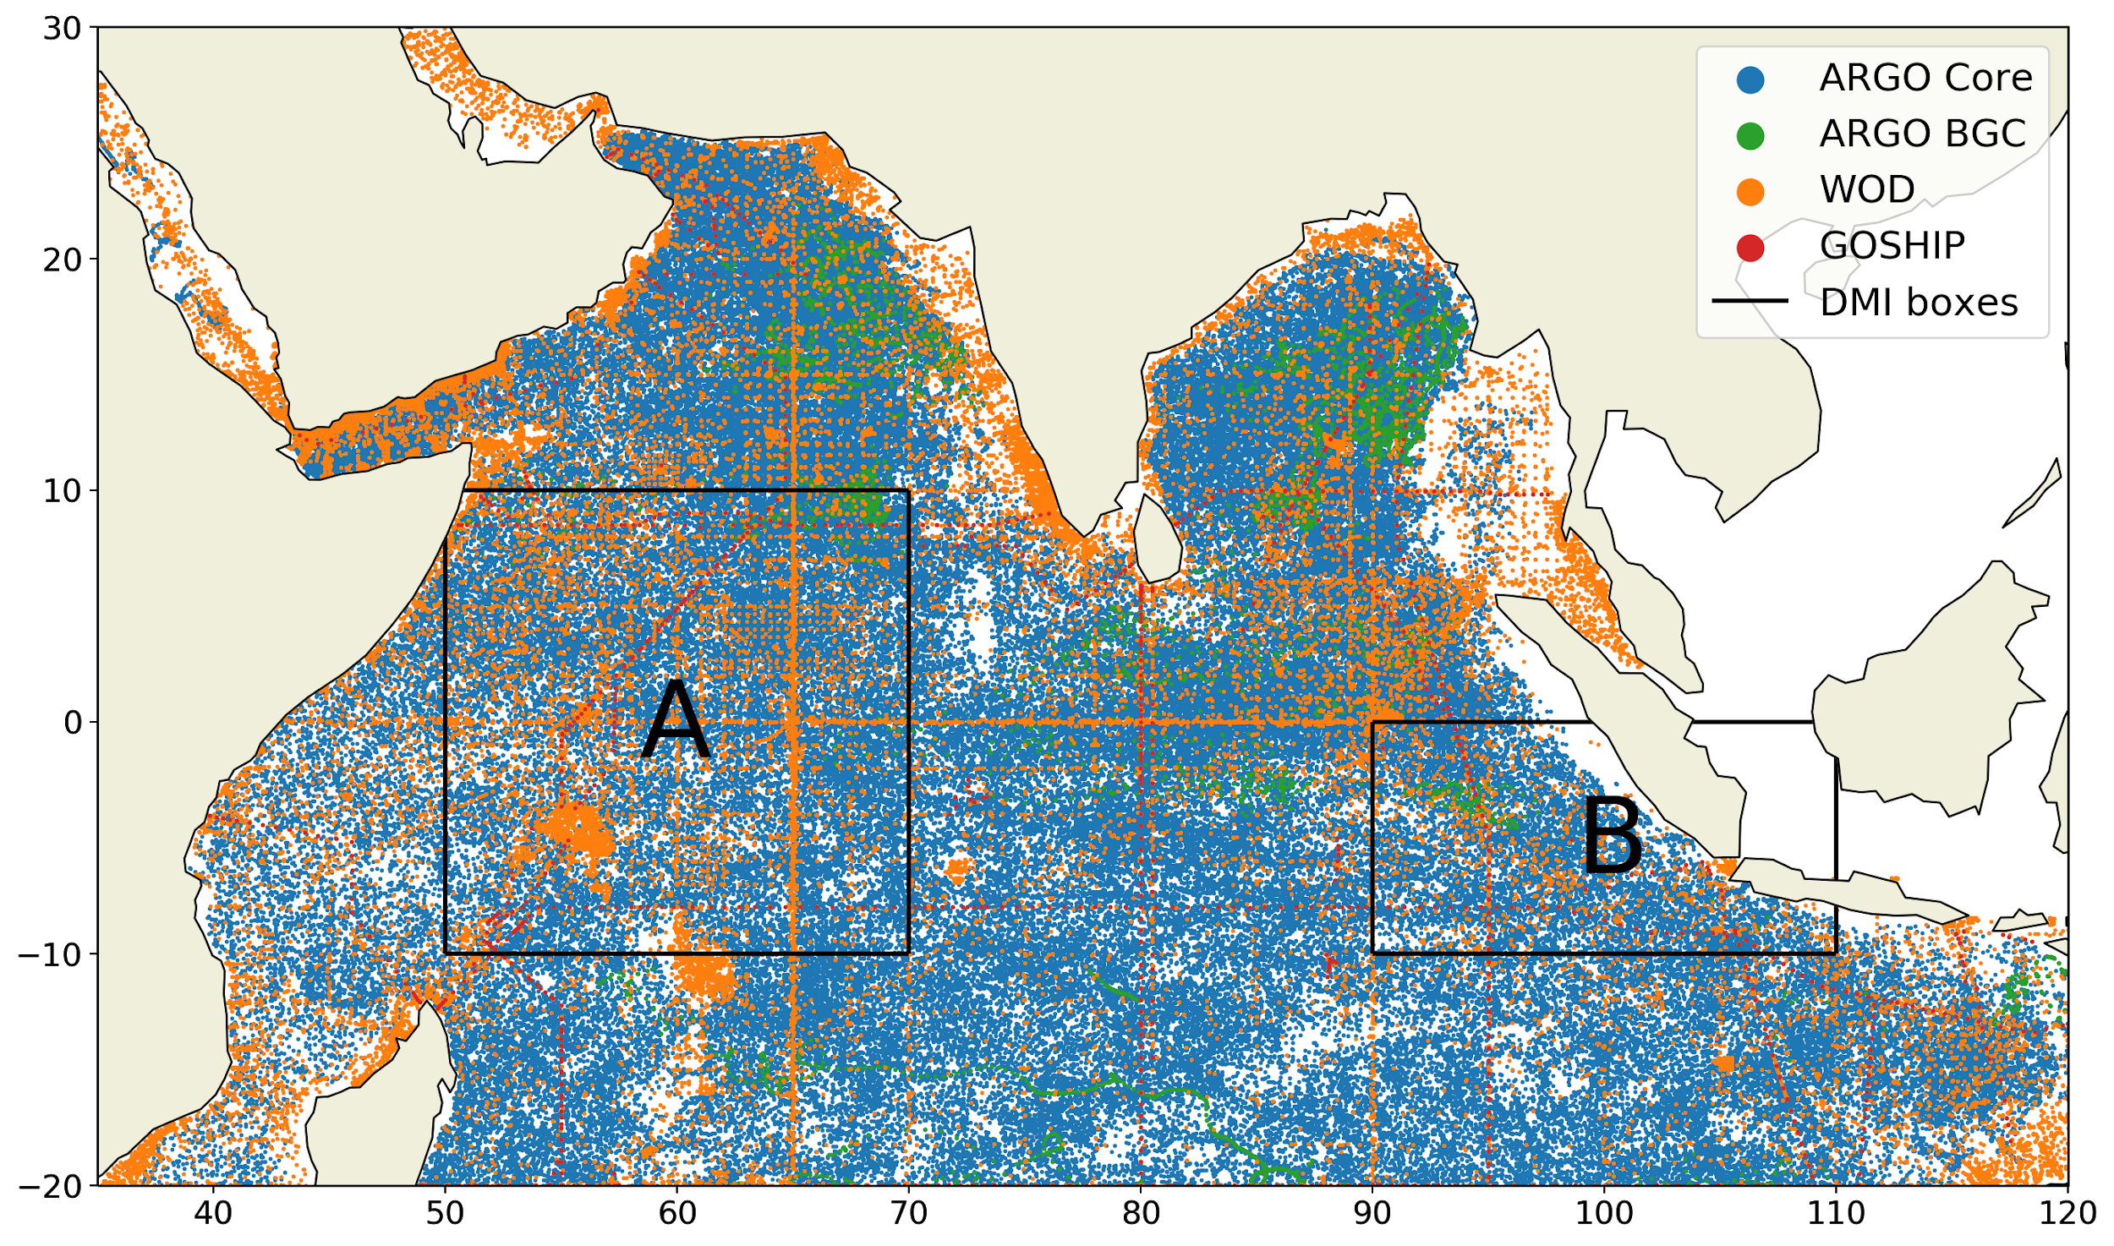
2). Methode: Données
Spatial distribution of the profiles used in this study colored by database: ARGO (Blue), ARGO BGC (Green), World Ocean Database 18 (Orange) and GOSHIP (Red). Boxes A and B are used to calculate the Dipole Mode Index (DMI), by calculating the difference between the sea surface temperature anomalies of box A (Western Tropical Indian Ocean SST index - WTIO) and box B (Southeastern Tropical Indian Ocean SST index - SETIO).
Time distribution of the profiles used in this study colored by database: ARGO (Blue), ARGO BGC (Green), World Ocean Database 18 (Orange) and GOSHIP (Red).

Slide 5
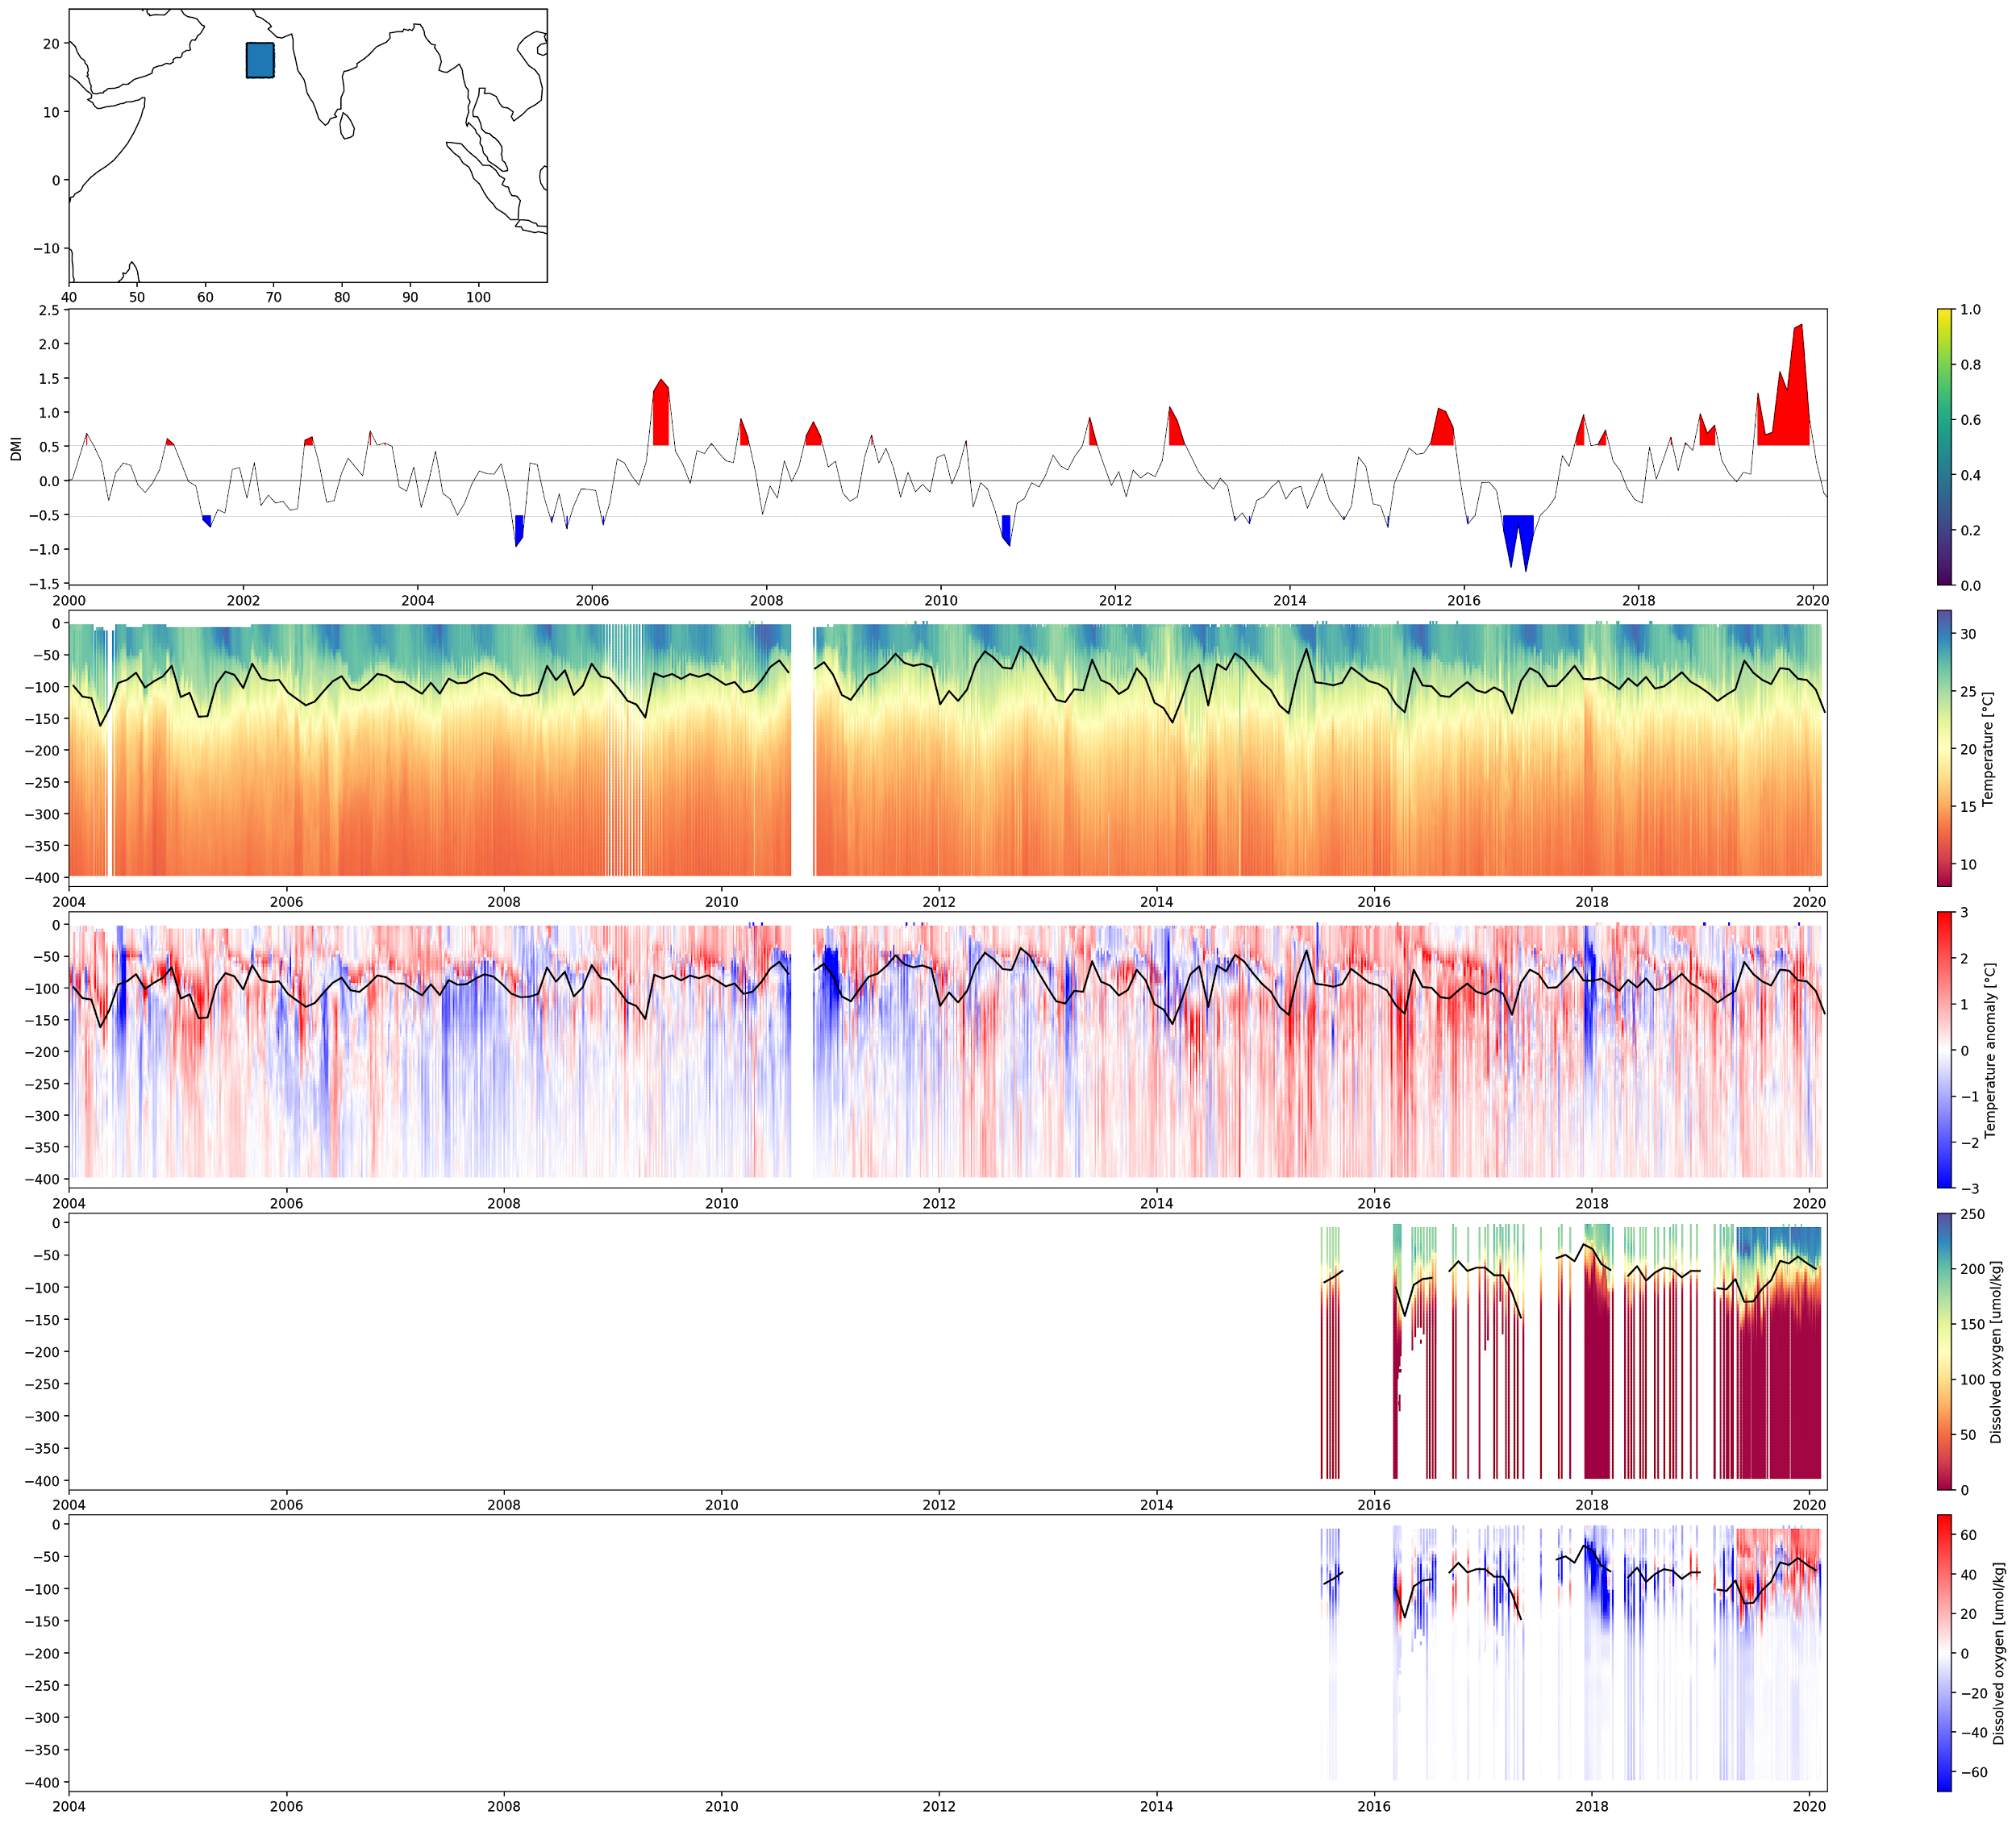
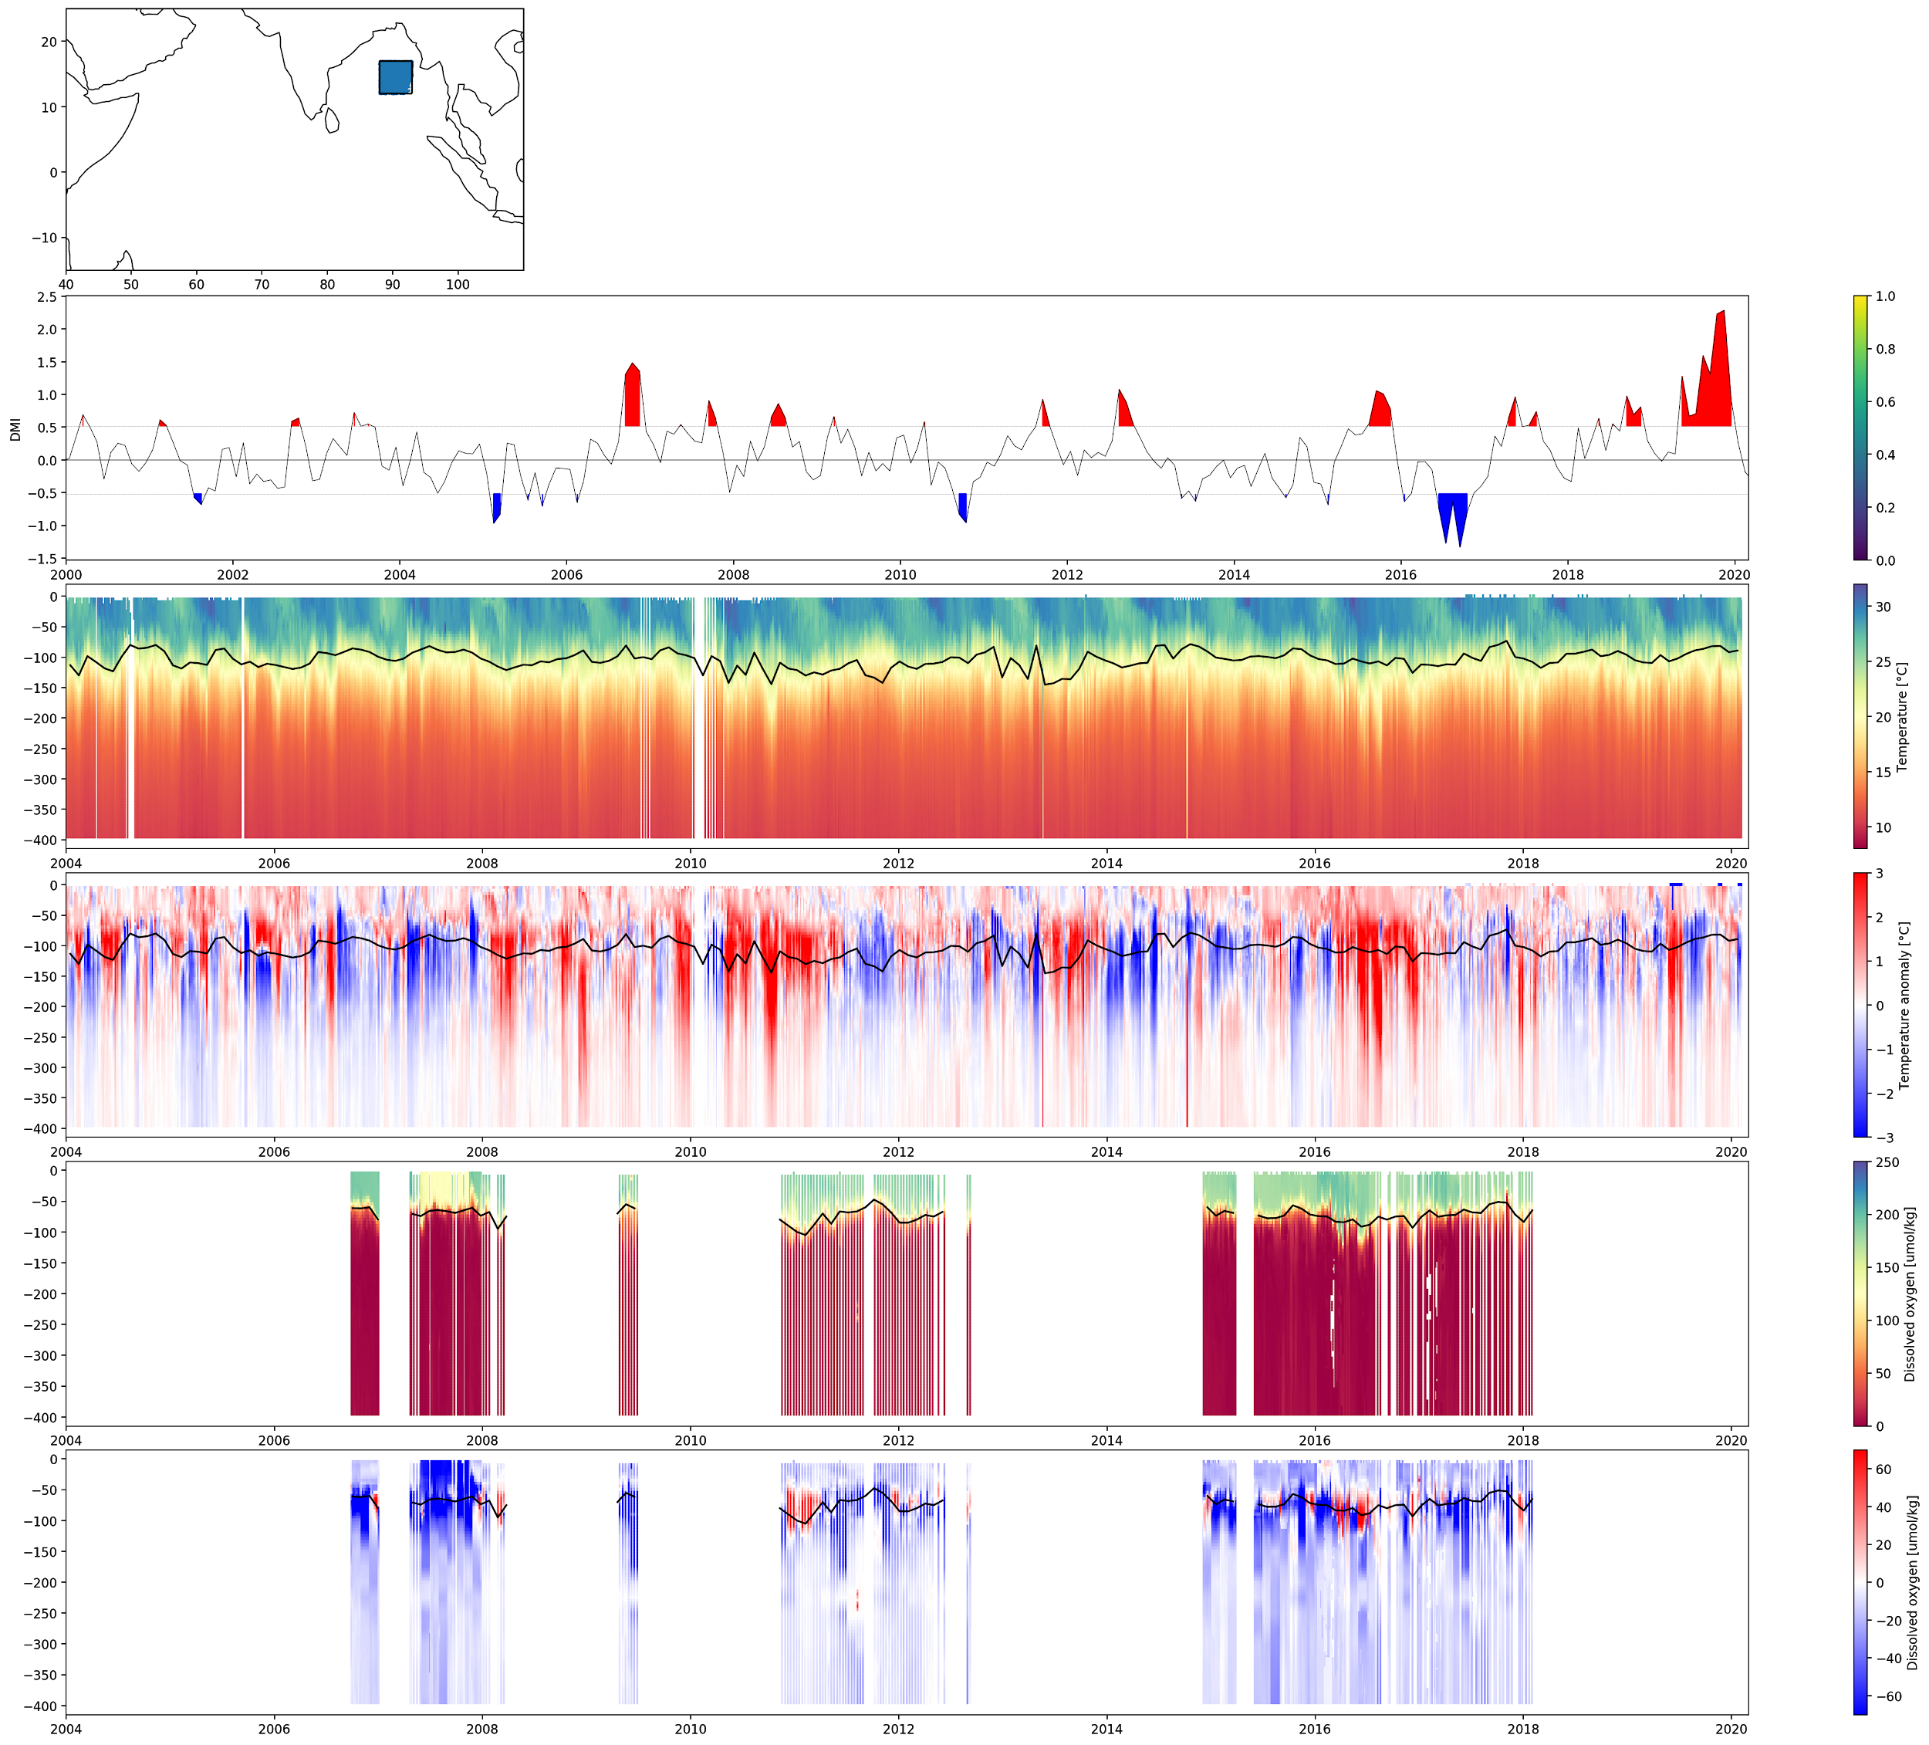
2). Time series
a)
a)
b)
b)
c)
c)
d)
d)
e)
e)
f)
f)
a) Selected study area. b). Time series of the DMI (solid line), the positive and negative phases of the DMI are respectively colored red and blue. c). Time series of the temperature profiles measured by the different profilers in the selected area. Monthly average thermocline (solid line). d). Temperature anomaly calculated compared to the world ocean atlas. Monthly mean thermocline (Solid line). e) Time series of dissolved oxygen concentration profiles measured by the different profilers in the selected area. Monthly mean Oxycline (Solid line). f). Anomaly of oxygen concentration calculated compared to the world ocean atlas. Monthly average Oxycline (Solid line).

Slide 6
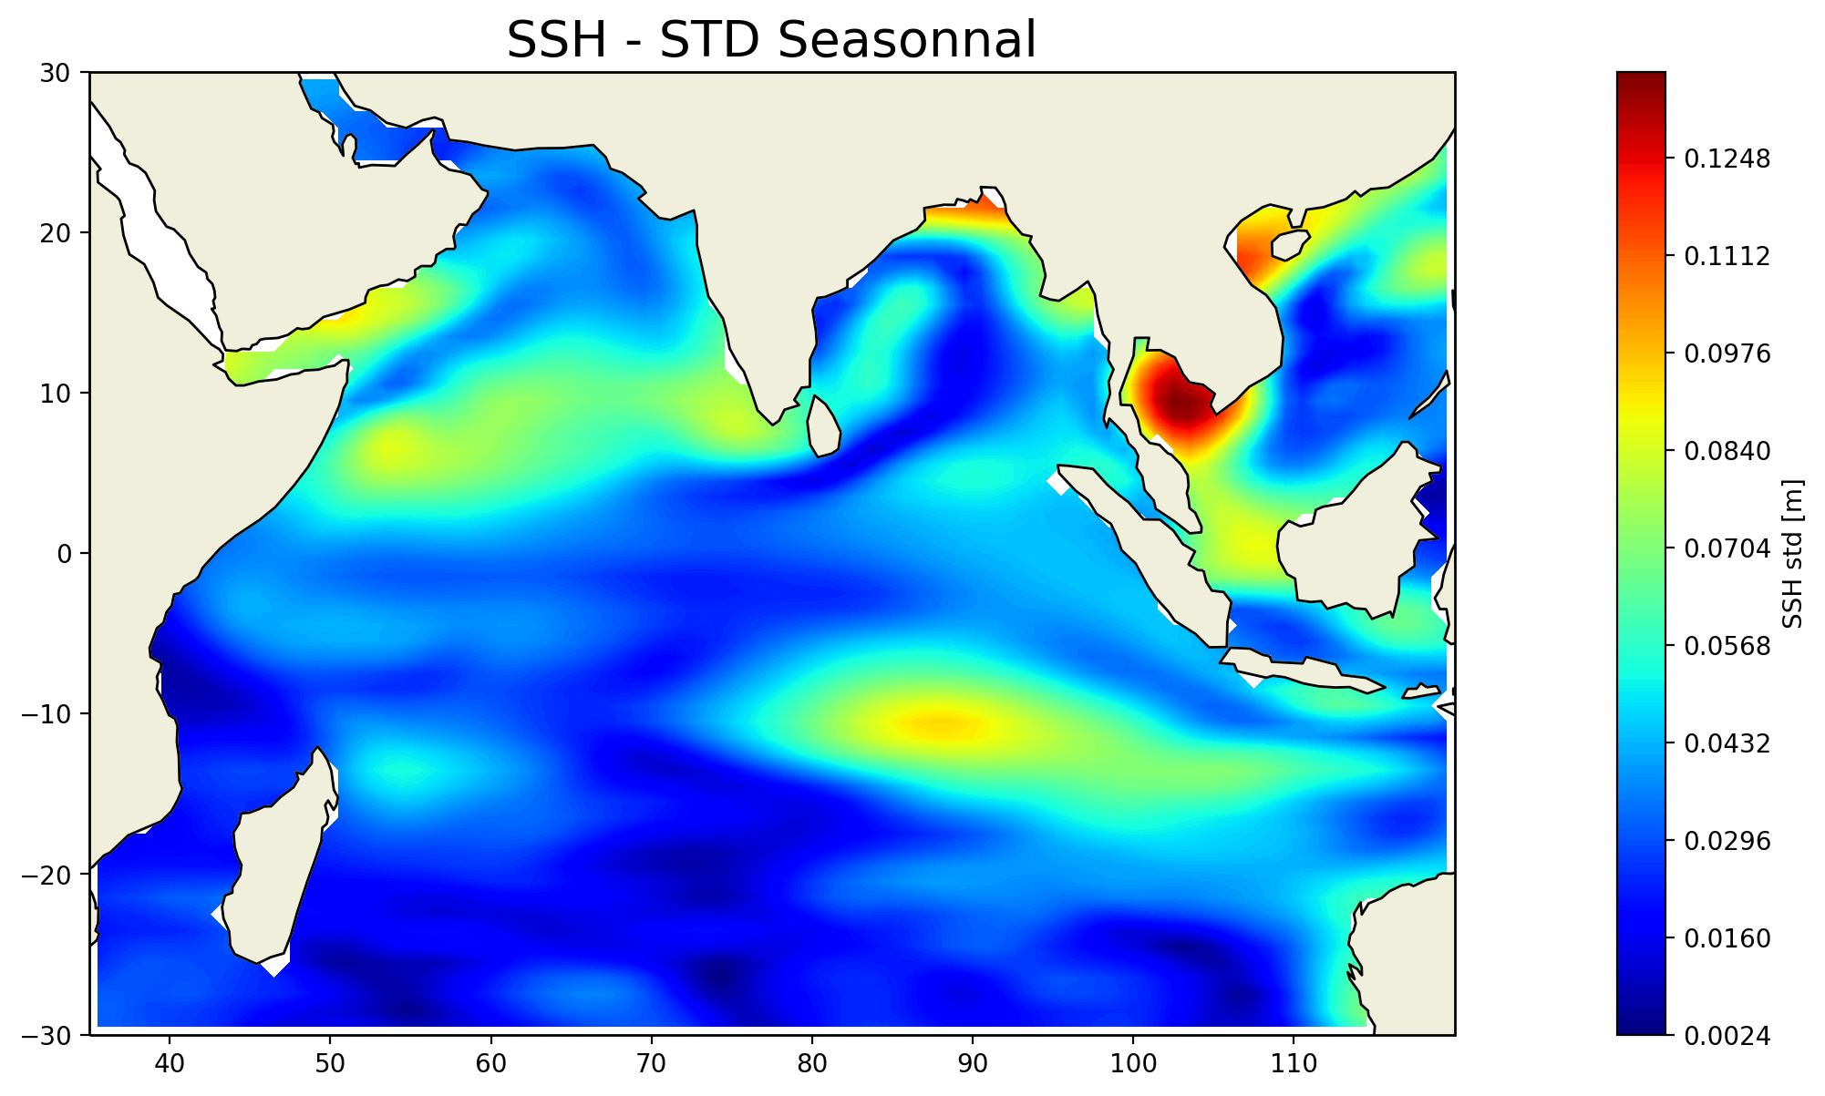
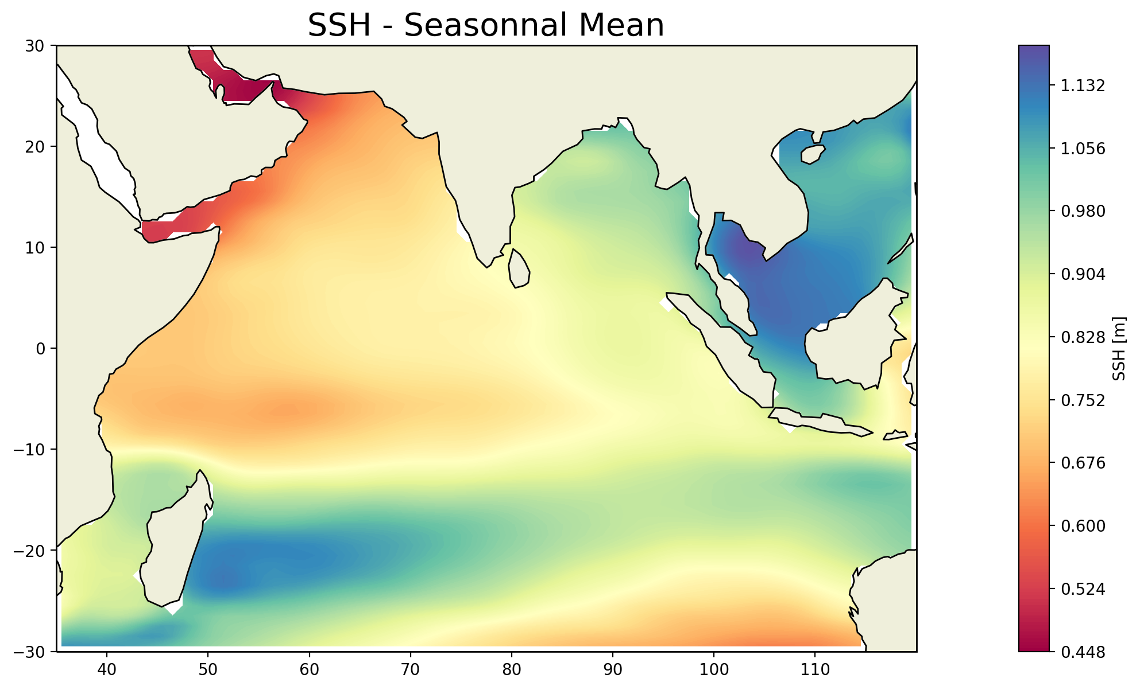
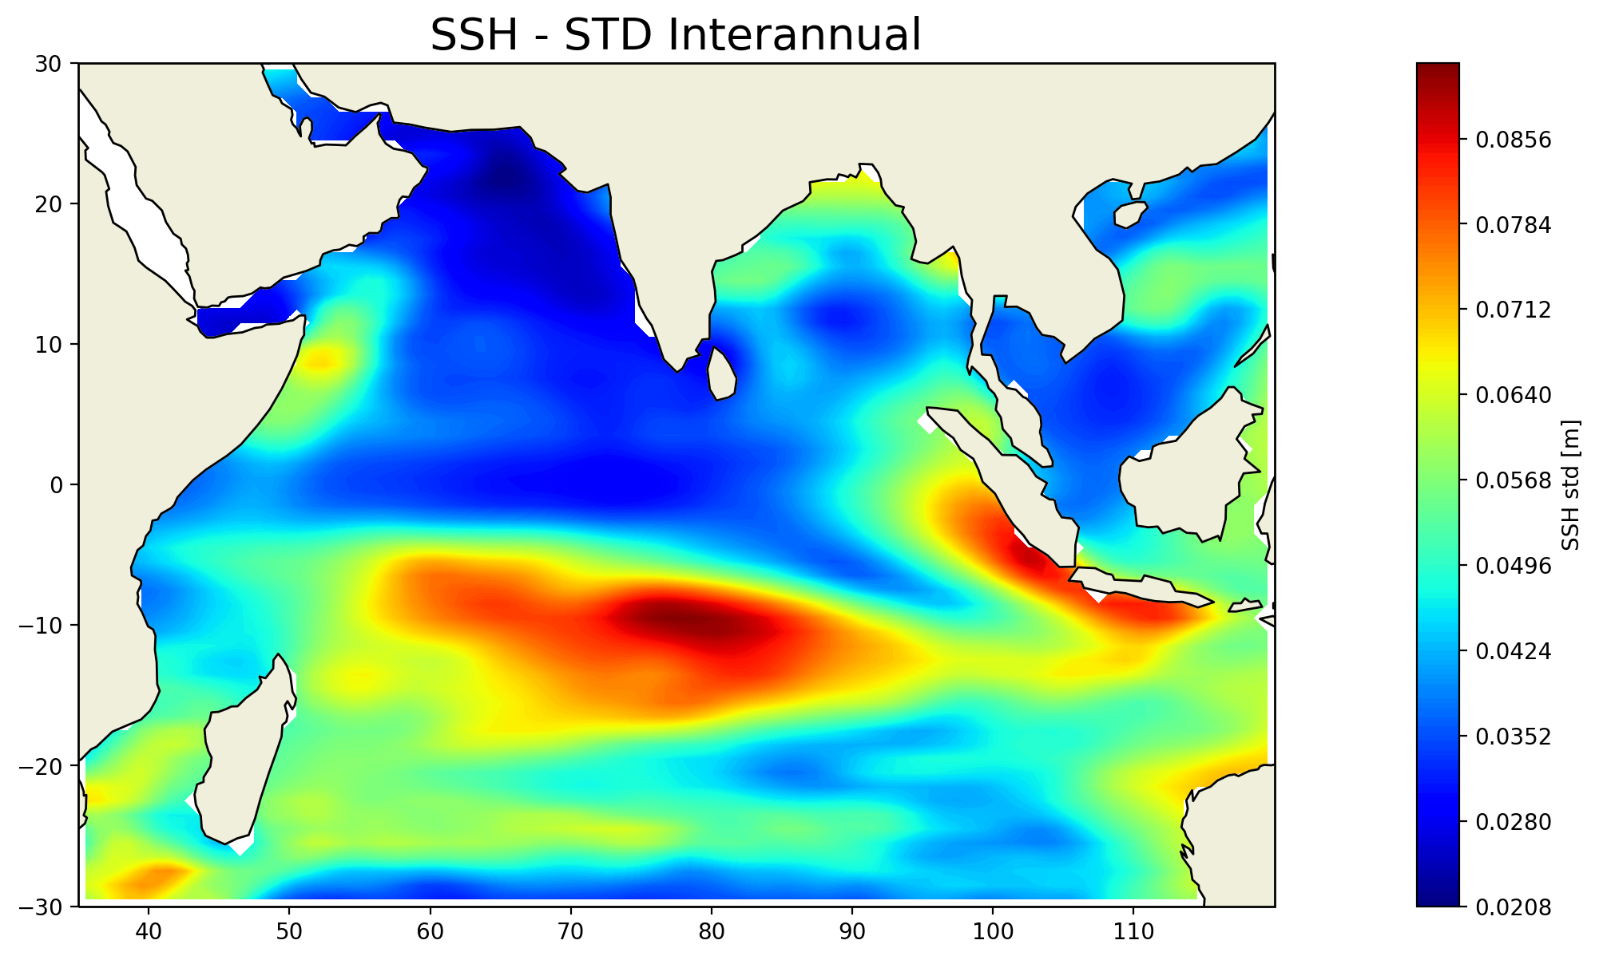
1).Climatologie de l’océan Indien: SSH
a)
b)
Annual mean of sea surface height calculated from gridded sea surface heights above geoid (Obs-AVISO model output prepared for obs4MIPs NASA-JPL observation)
Seasonal [a] and interannual [b] standard deviation of sea surface height calculated from gridded sea surface heights above geoid (Obs-AVISO model output prepared for obs4MIPs NASA-JPL observation)
copier-coller à remplacer

Slide 7
resultats
IOD and oxycline

Slide 8
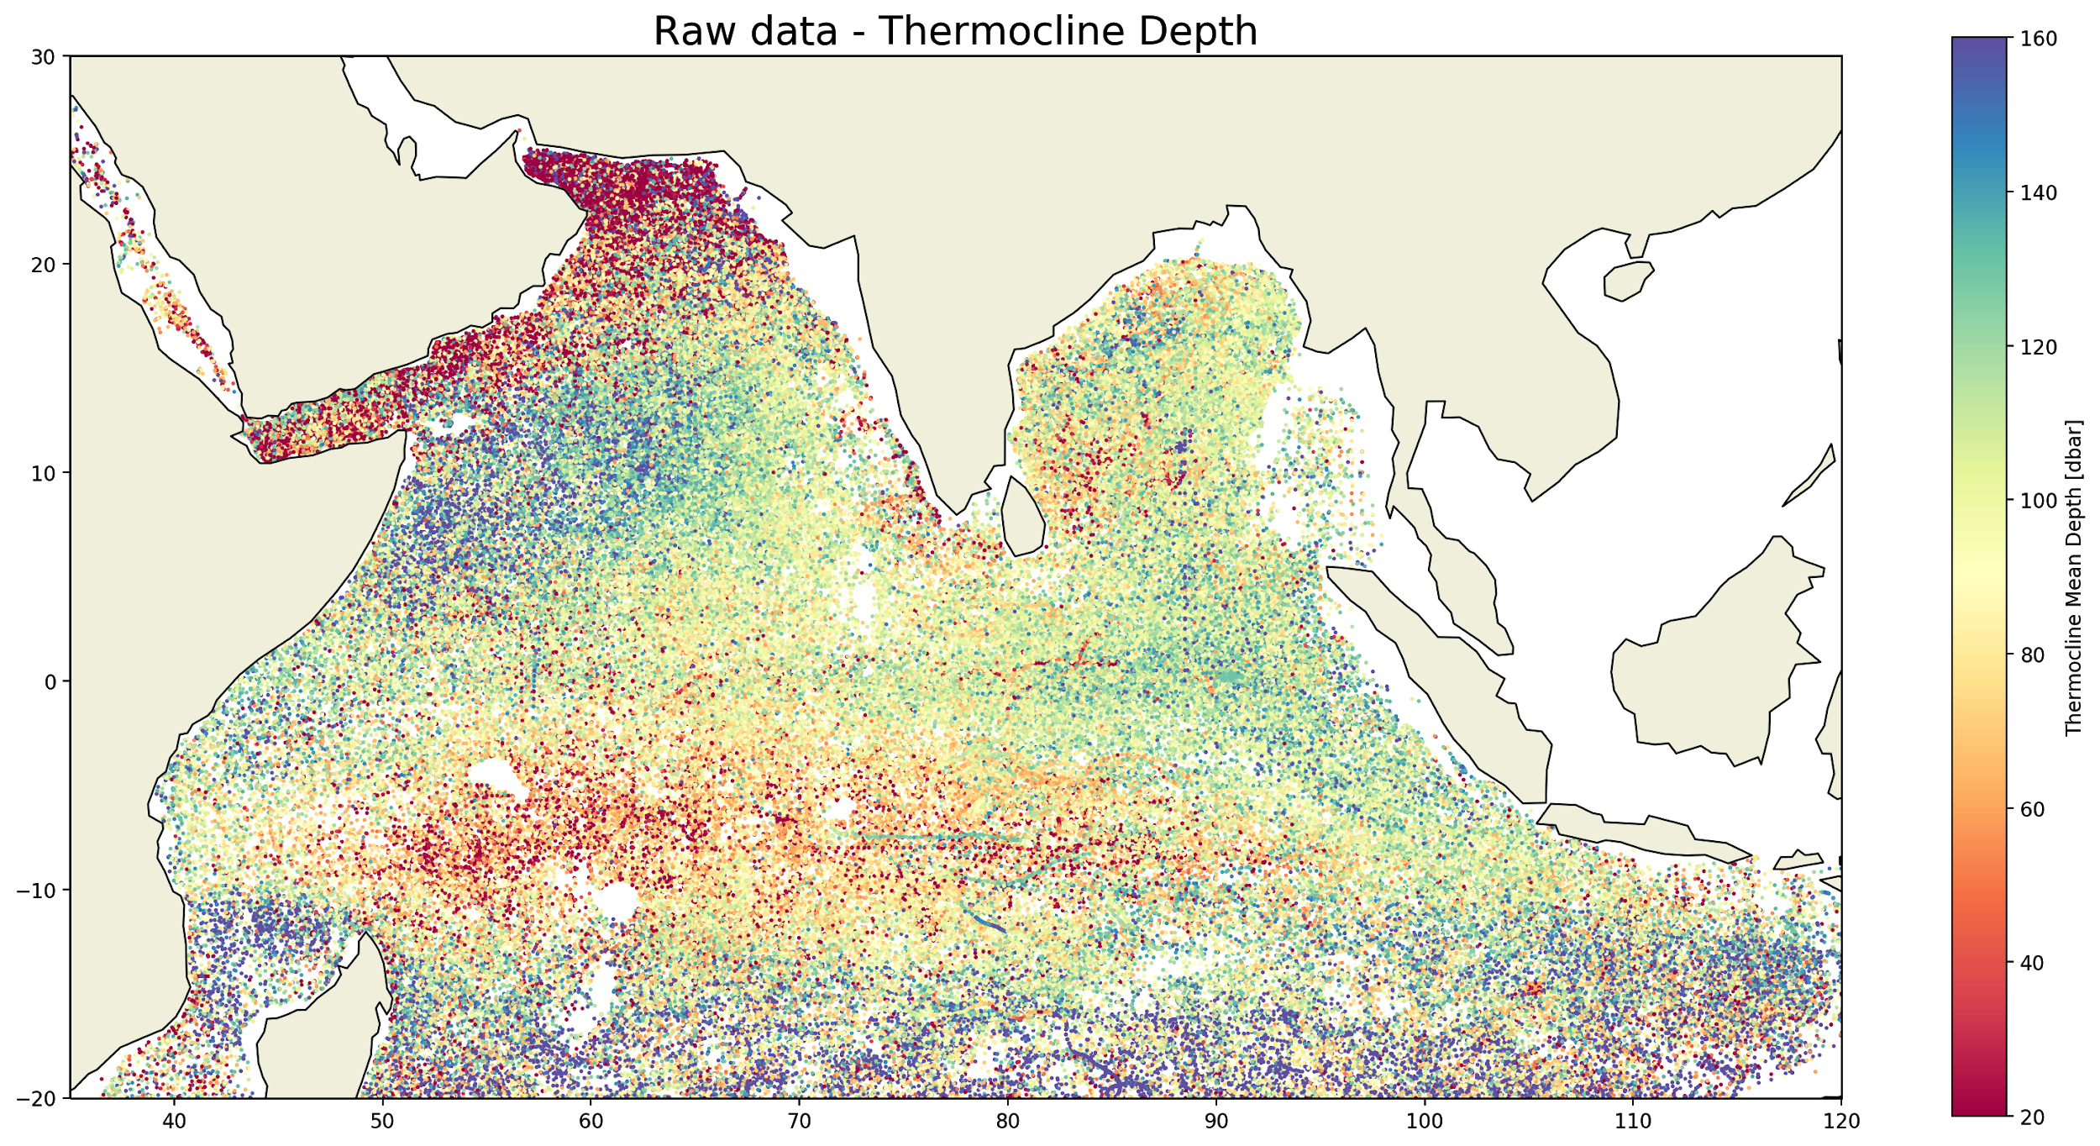
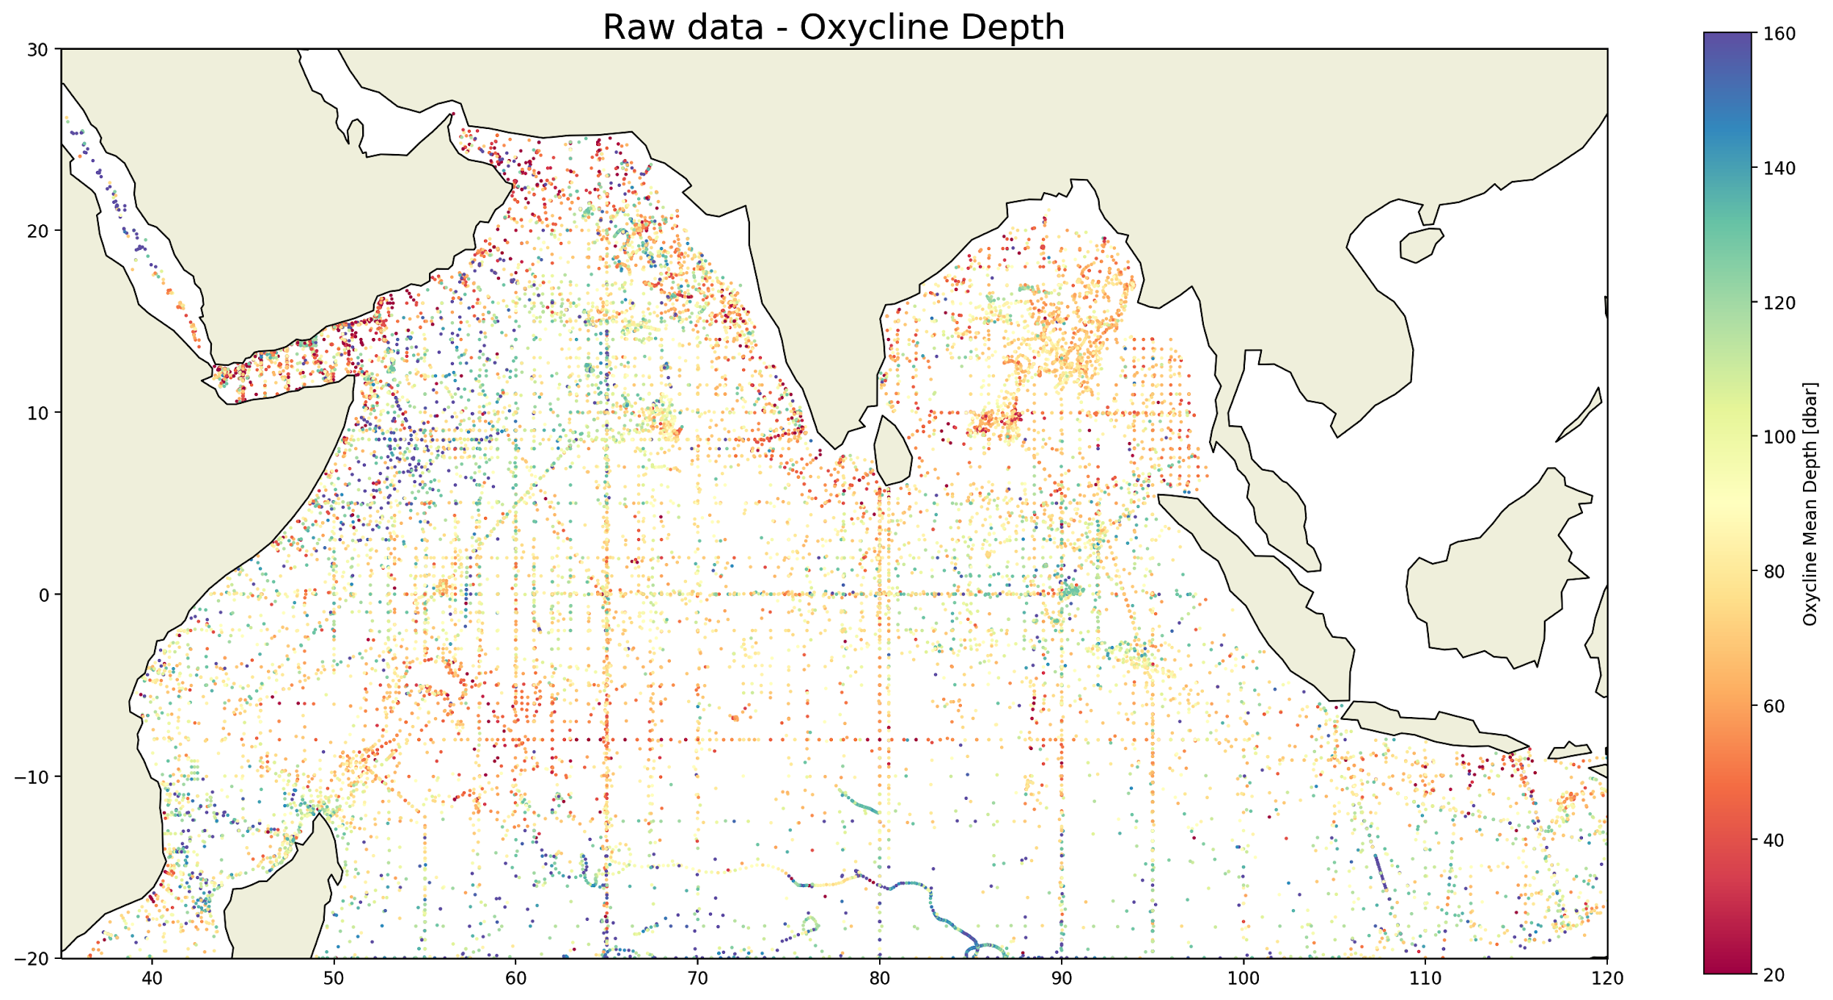
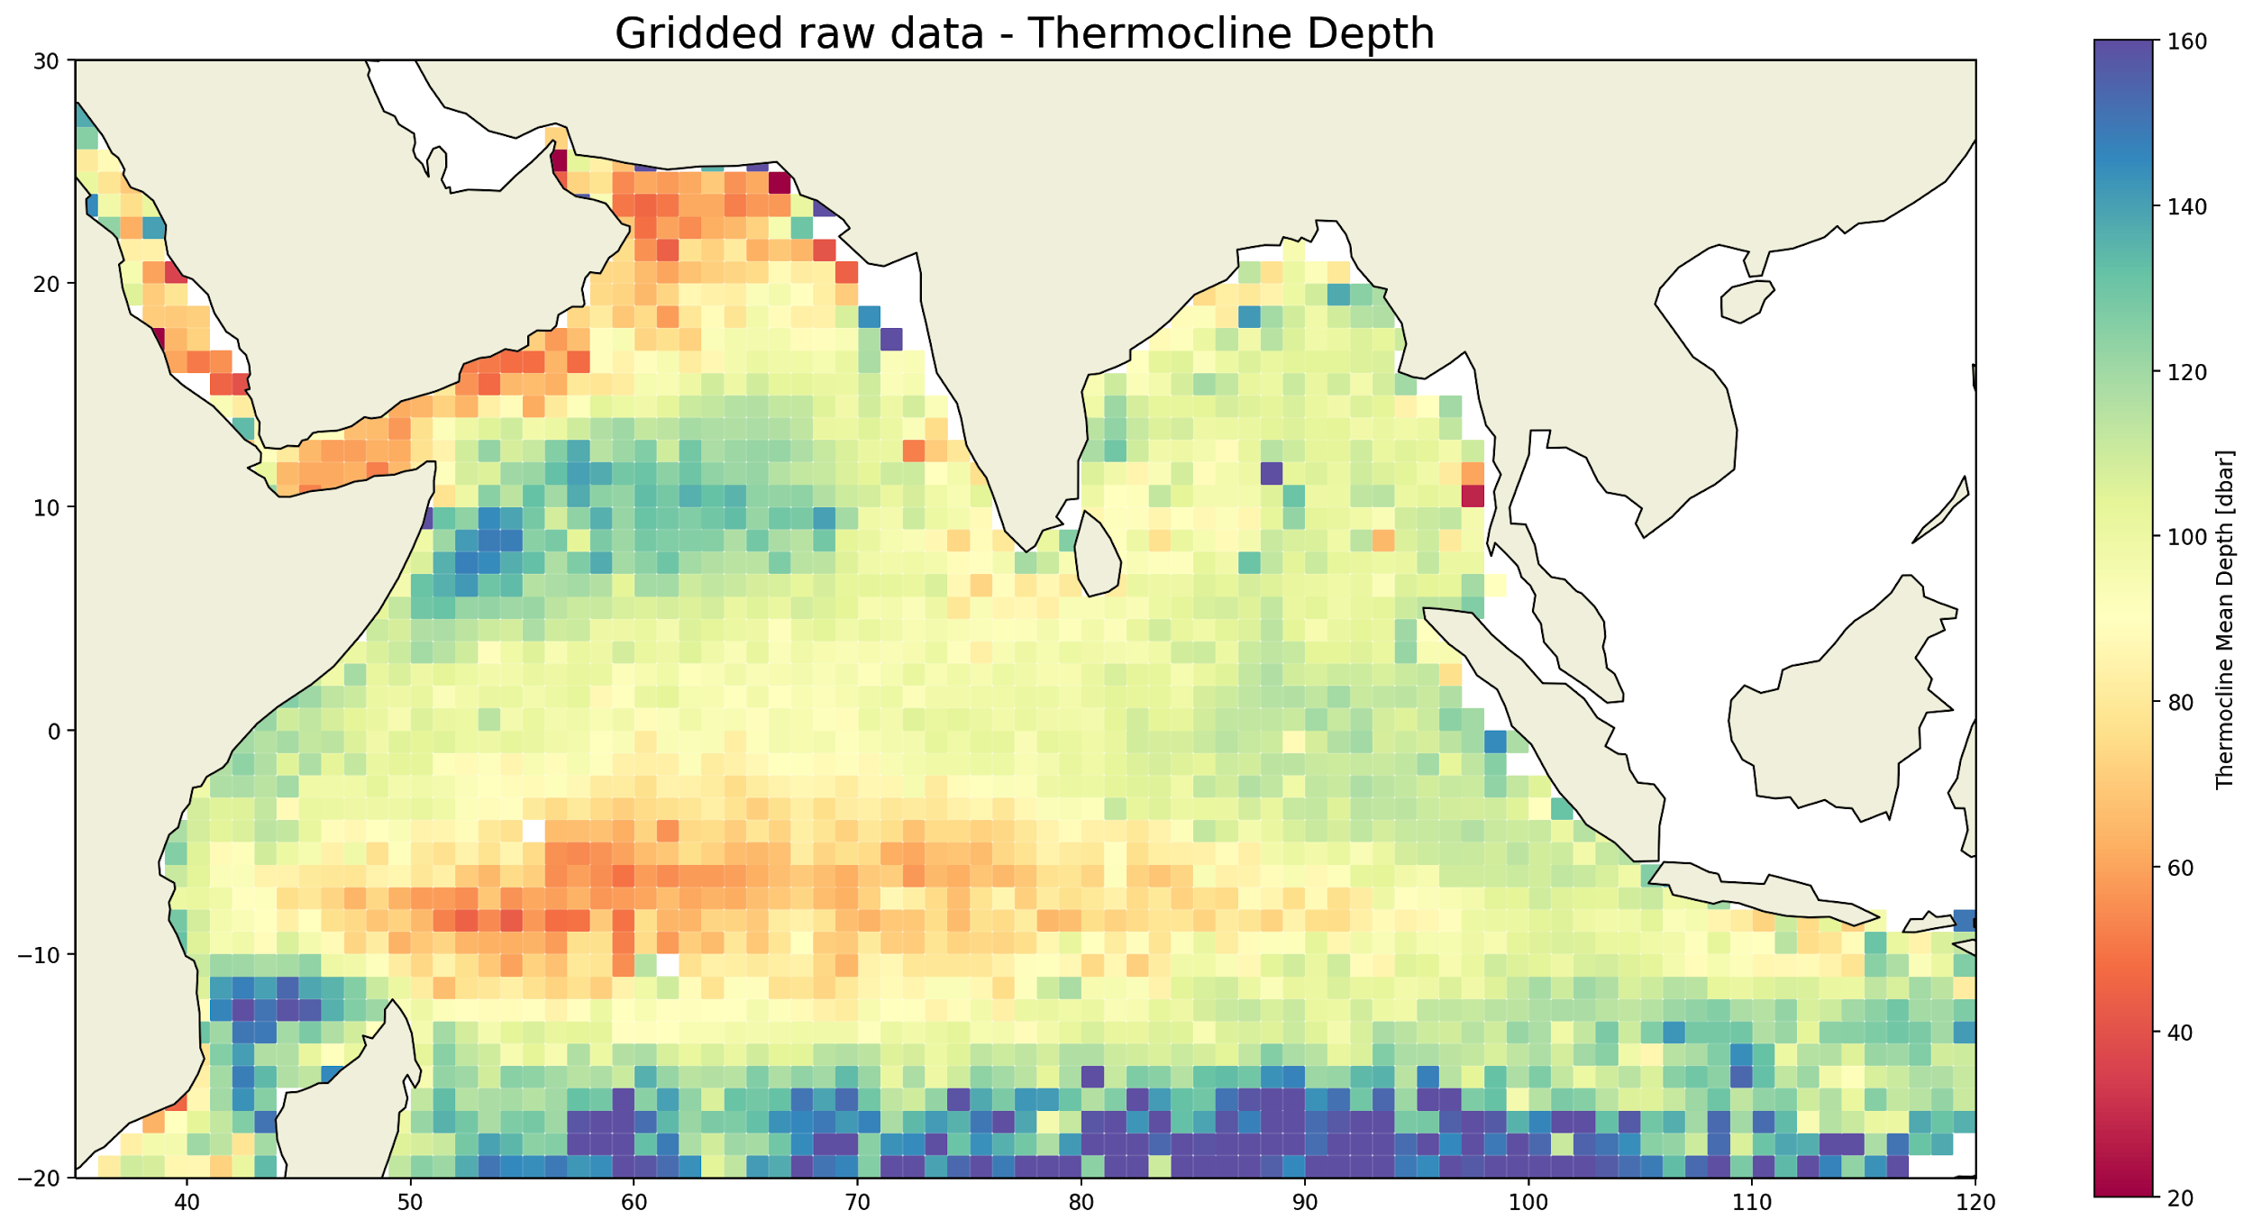
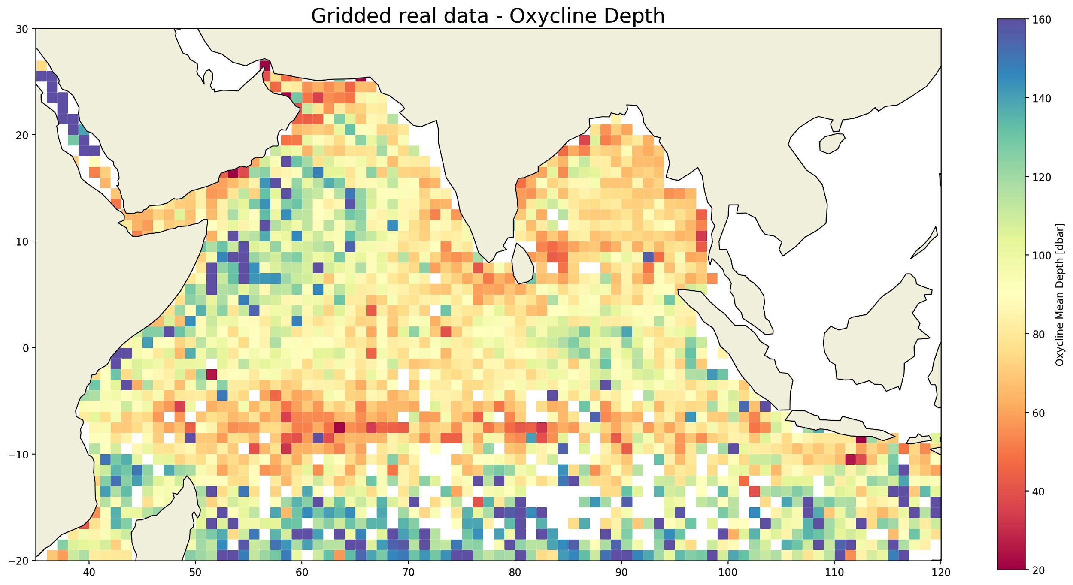
2).Calcul de thermocline et d’oxycline
Thermocline depth defined as the minimum temperature gradient depth for each profile.
Oxycline depth defined as the minimum dissolved oxygen concentration gradient depth for each profile.
Gridded mean thermocline depth. In each box, the thermocline depth corresponds to the mean thermocline depth of the profiles it contains.
Gridded mean Oxycline depth. In each box, the oxycline depth corresponds to the mean oxycline depth of the profiles it contains.

Slide 9
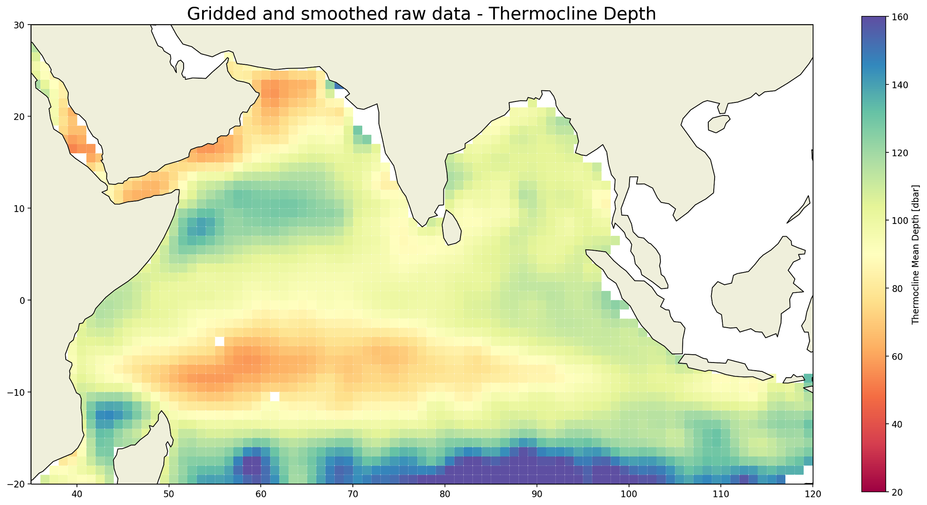
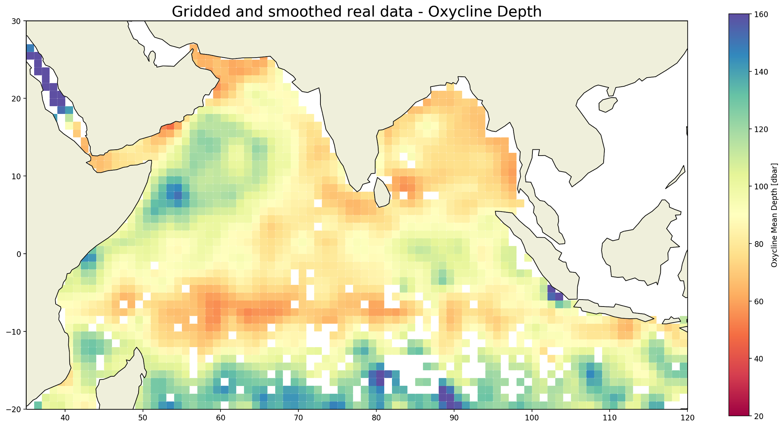
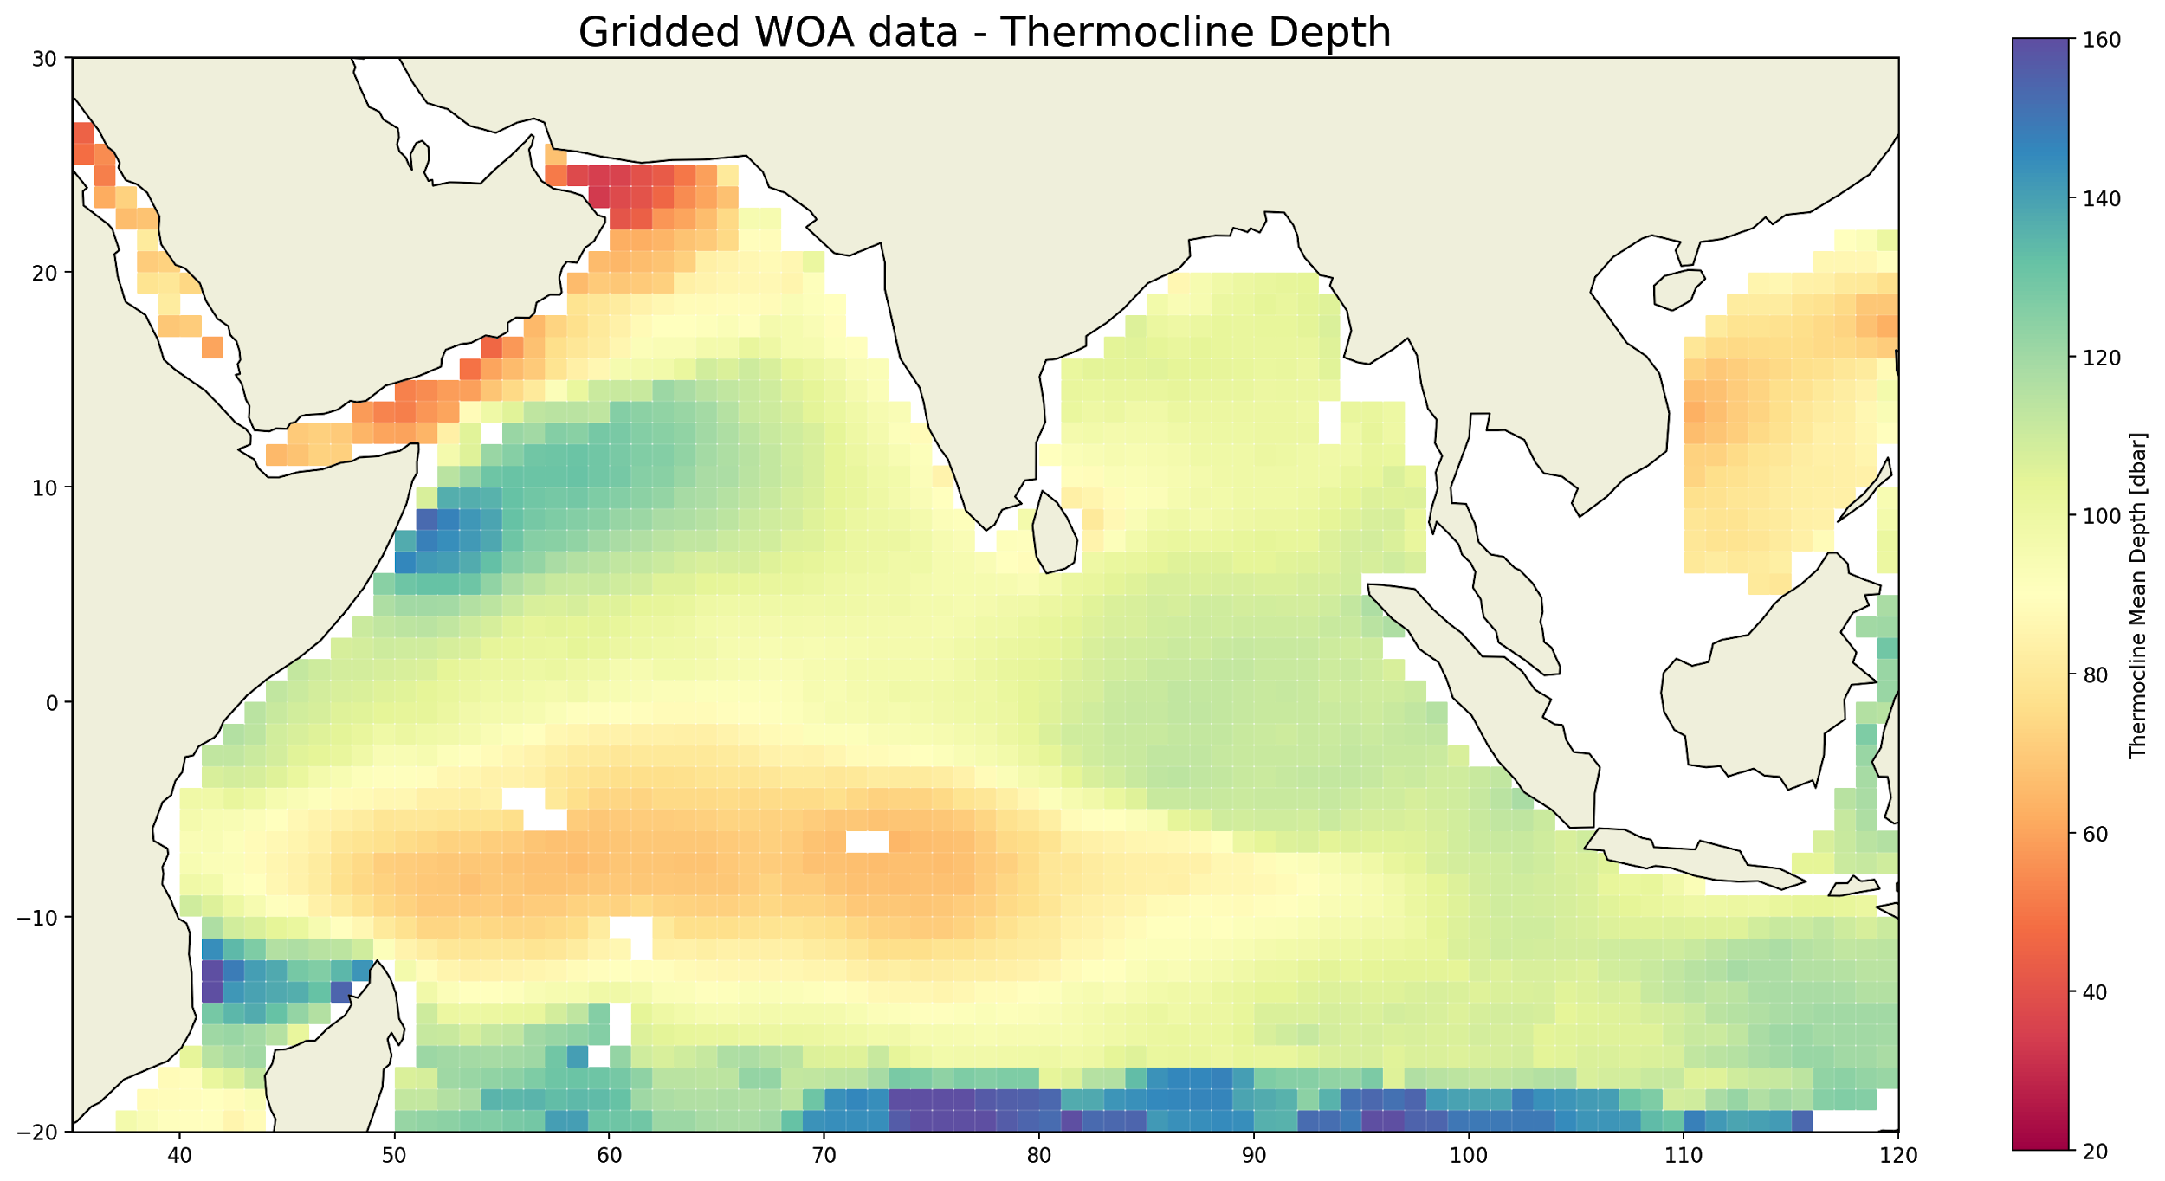
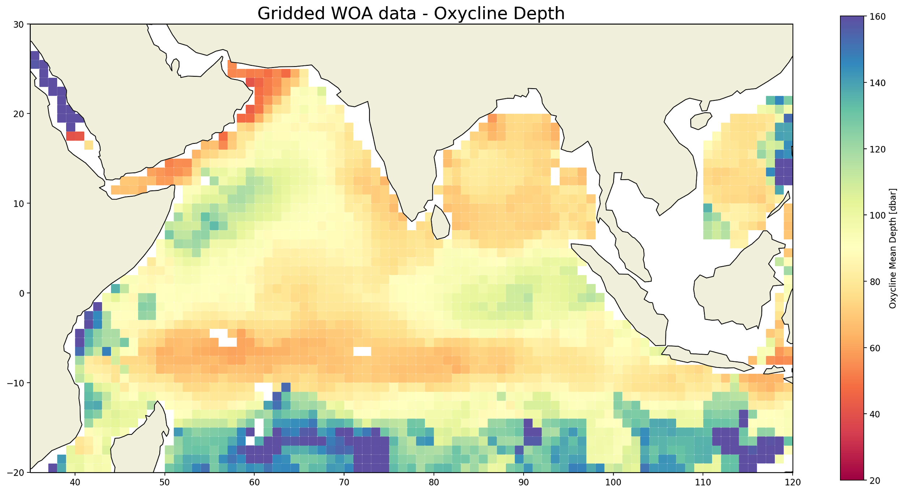
2). Comparaison entre les données brutes et le WOA
Gridded and smoothed mean thermocline depth using raw data. In each box, the thermocline depth corresponds to the mean thermocline depth of the profiles it contains. The smooth is realized with a Gaussian filter (sigma=1).
Gridded and smoothed mean oxycline depth using raw data. In each box, the oxycline depth corresponds to the mean oxycline depth of the profiles it contains. The smooth is realized with a Gaussian filter (sigma=1).
Gridded and smoothed mean thermocline depth using World ocean Atlas data. In each box, the thermocline depth corresponds to the mean thermocline depth of the profiles it contains. The smooth is realized with a Gaussian filter (sigma=1).
Gridded and smoothed mean oxycline depth using World ocean Atlas data. In each box, the oxycline depth corresponds to the mean oxycline depth of the profiles it contains. The smooth is realized with a Gaussian filter (sigma=1).

Slide 10
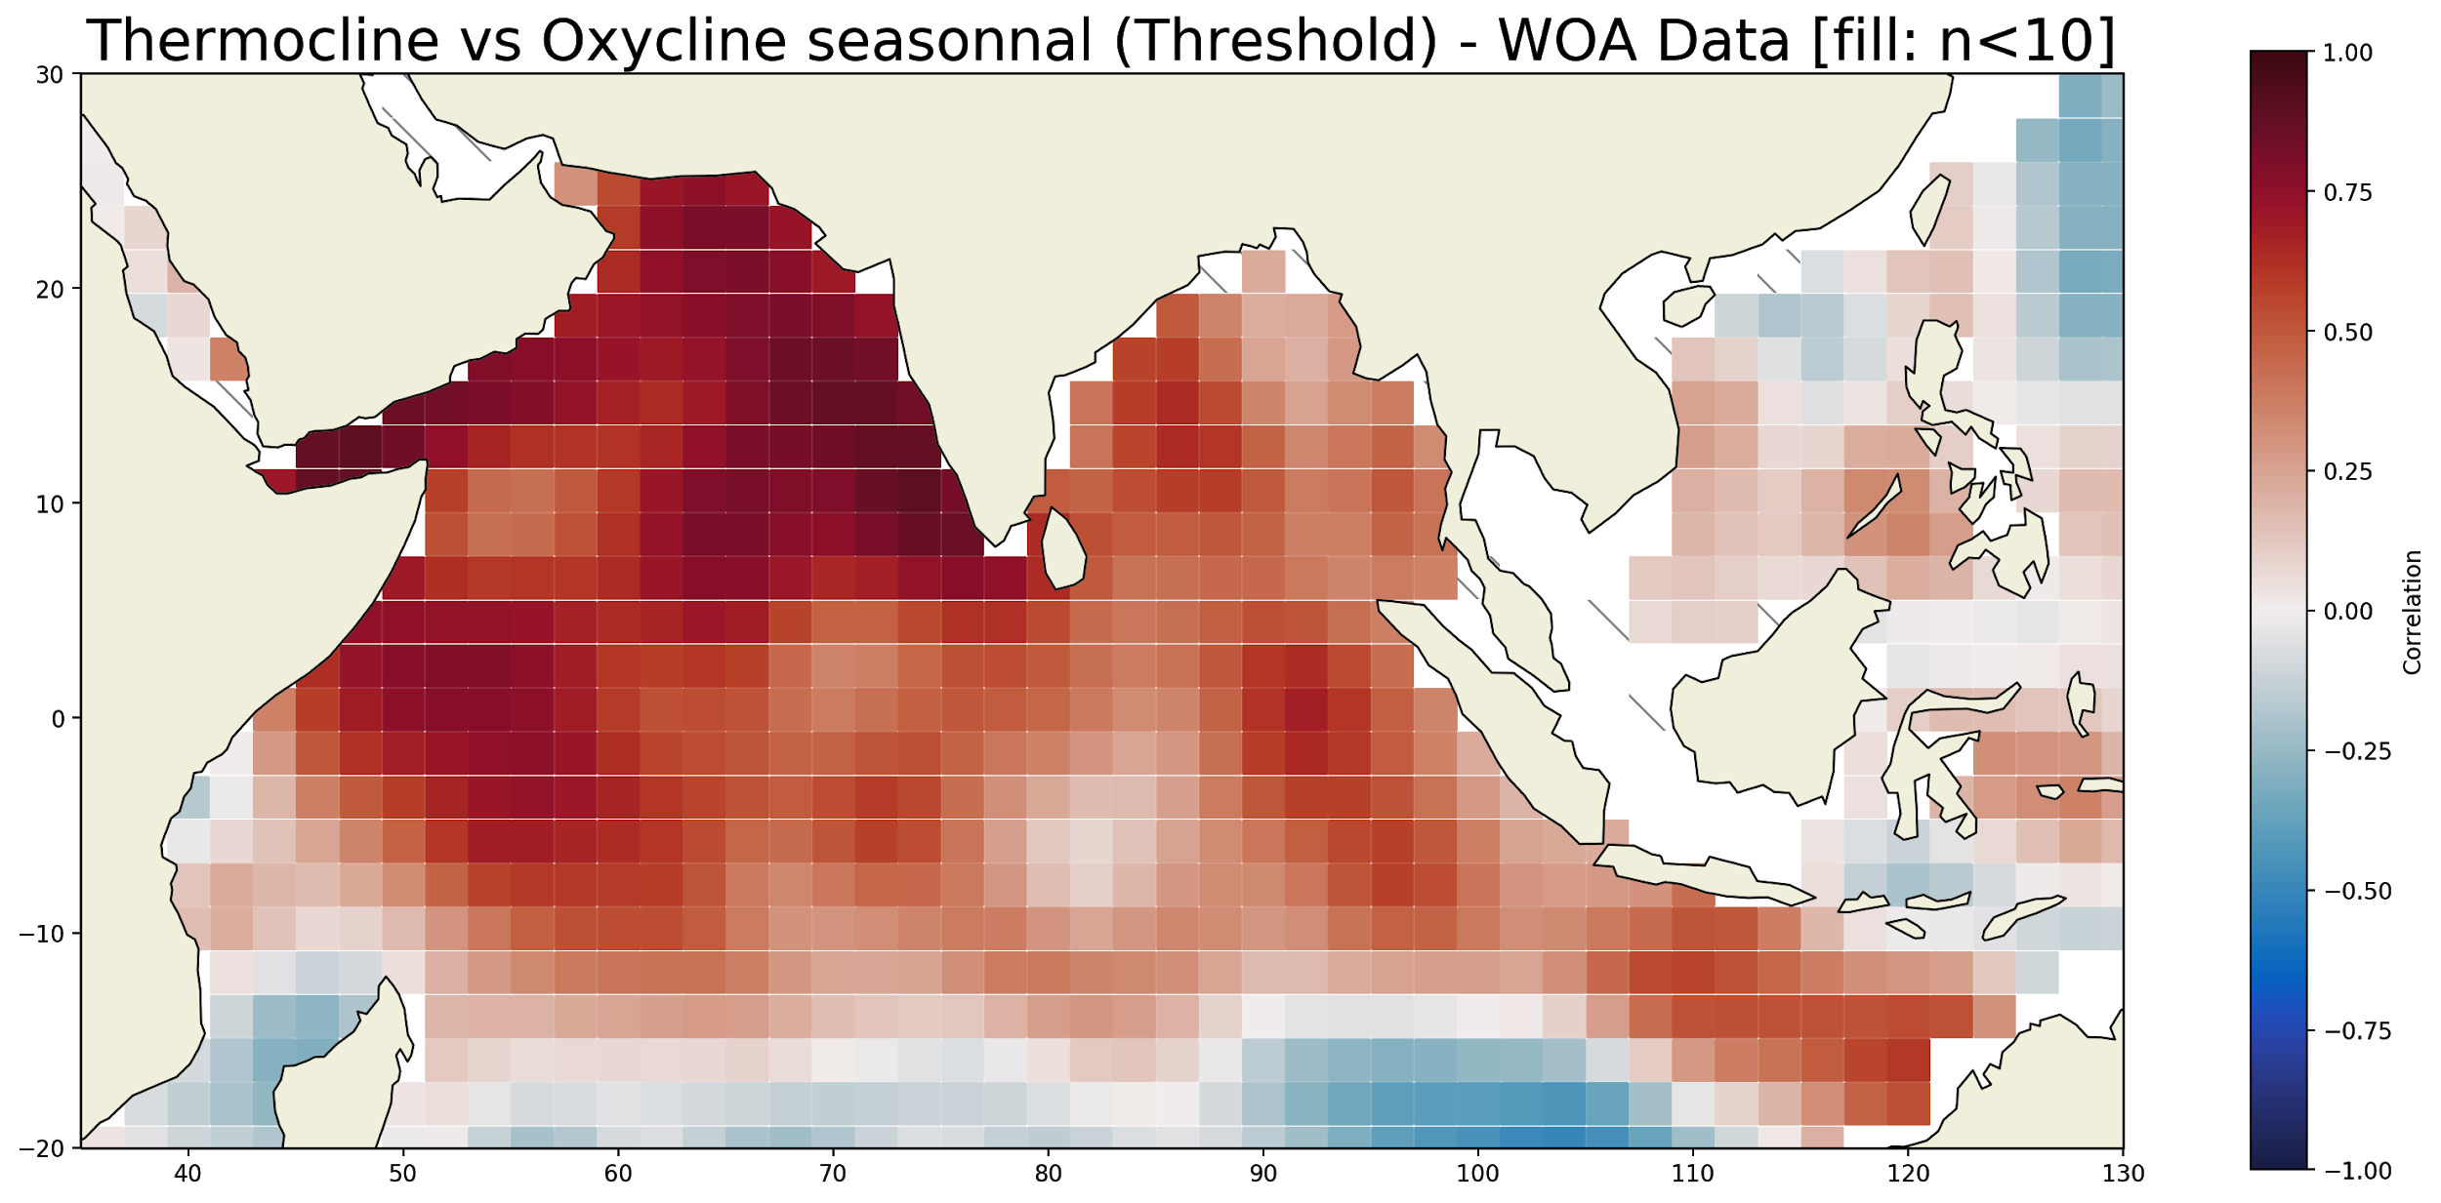
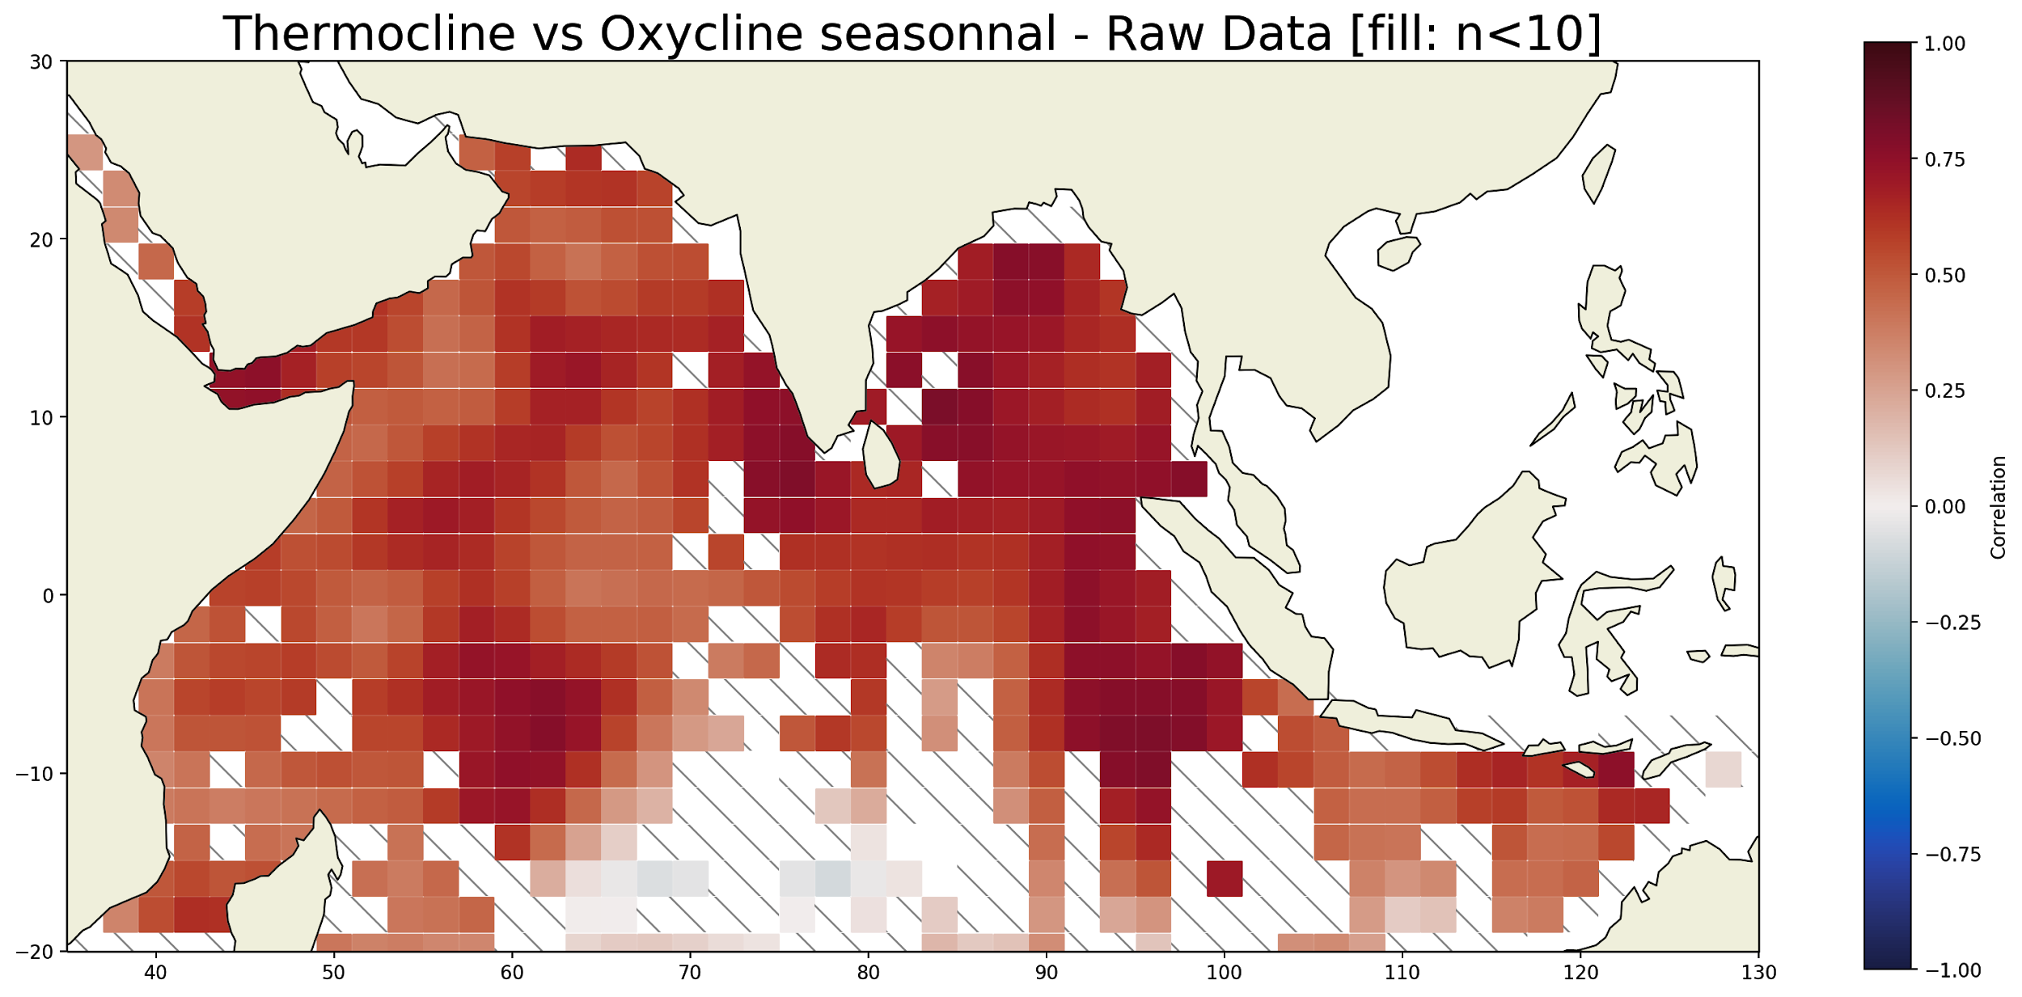
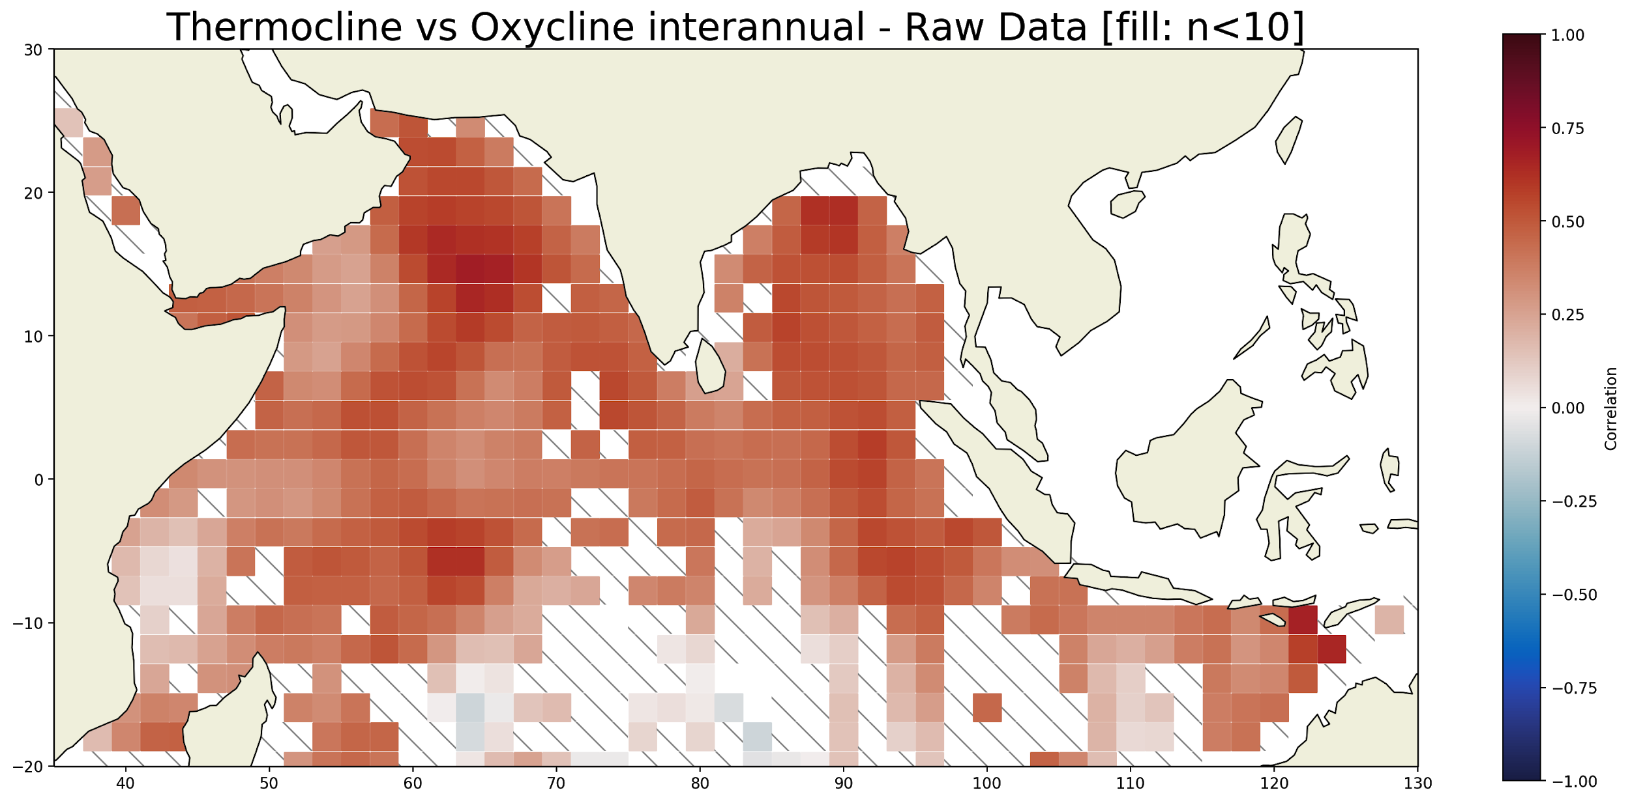
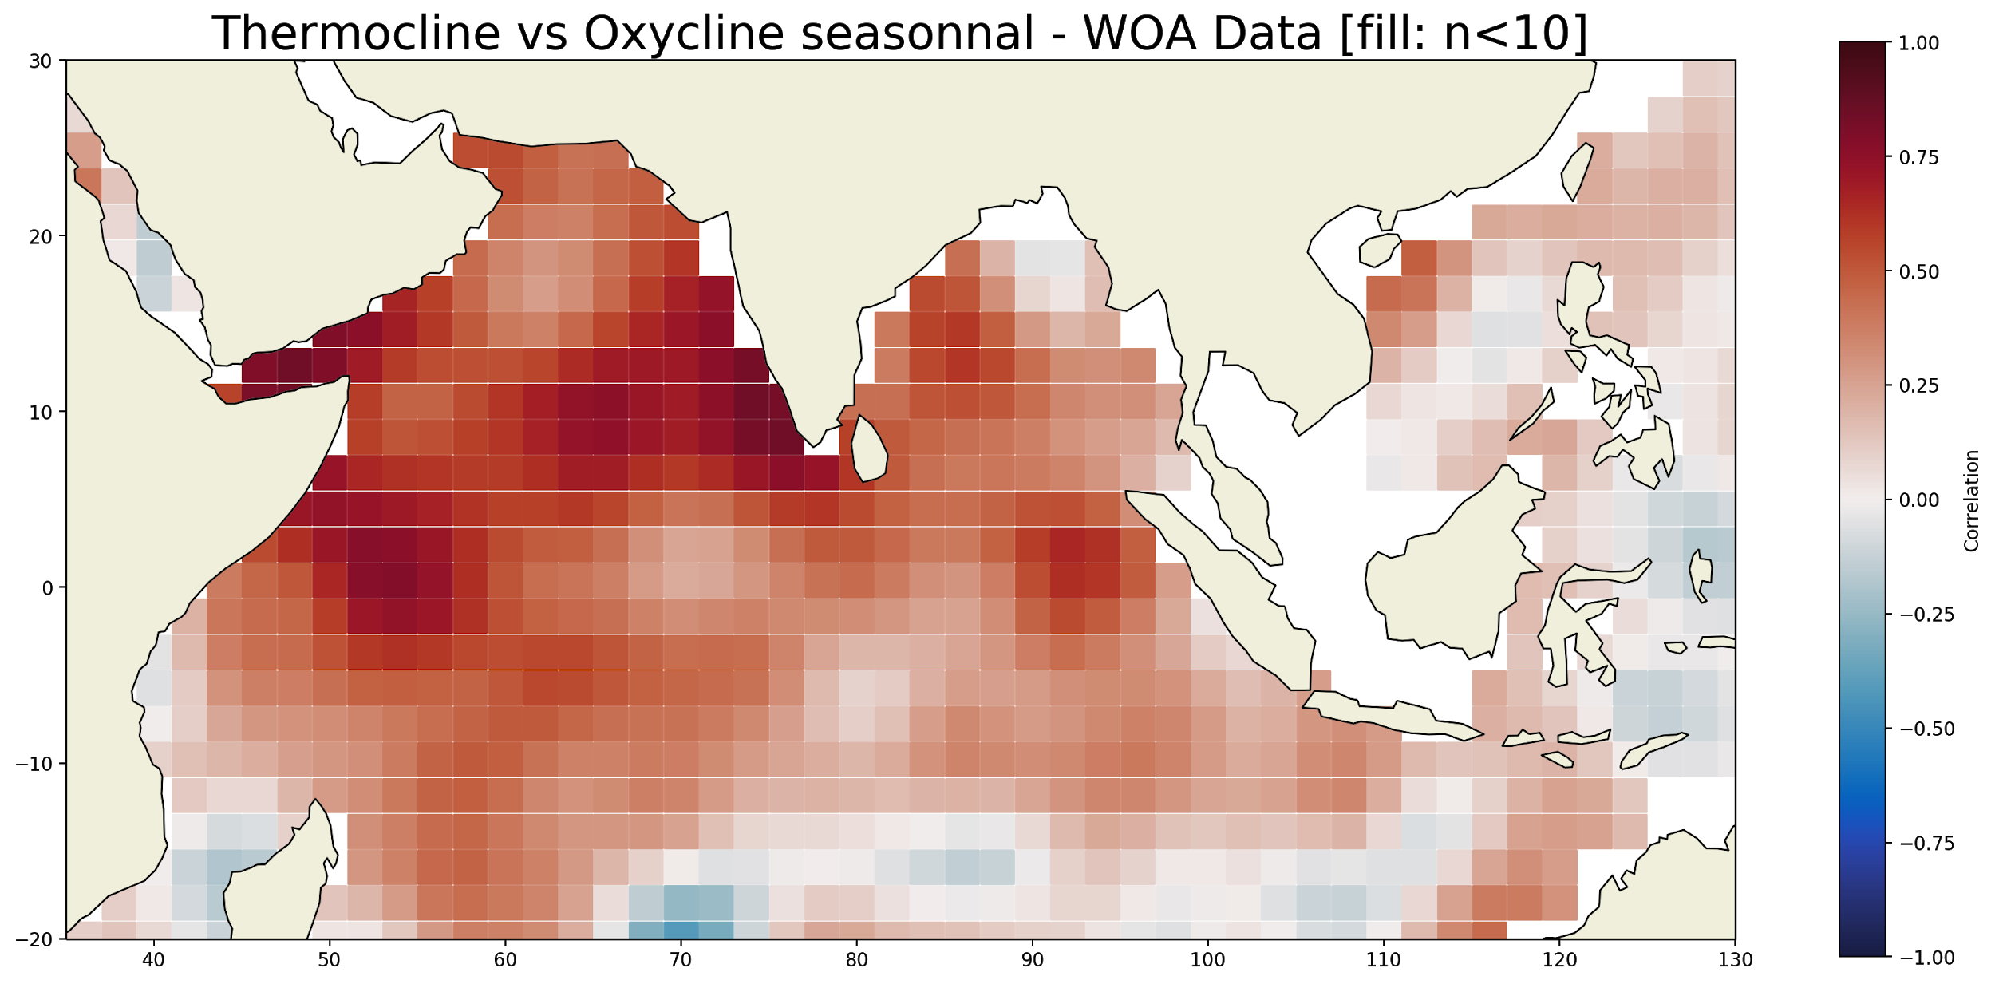
3). Corrélation entre l’oxycline et la thermocline
Seasonal correlation between thermocline depth and oxycline depth using world ocean atlas data. In each box the correlation is calculated by taking each pair of thermocline oxycline points from the same profile. The correlation is calculated only if there are more than 10 point pairs. Thermocline and Oxycline depth are defined as thresholds: 23°C and 155 umol/kg
Seasonal correlation between thermocline depth and oxycline depth using raw data. In each box the correlation is calculated by taking each pair of thermocline oxycline points from the same profile. The correlation is calculated only if there are more than 10 point pairs, otherwise the box is hatched in grey. Thermocline and Oxycline depth defined as the minimum temperature and oxygen gradient depth
Interannual correlation between thermocline depth and oxycline depth using raw data. In each box the correlation is calculated by taking each pair of thermocline oxycline anomaly points from the same profile (obtained by removing the WOA monthly mean). The correlation is calculated only if there are more than 10 point pairs, otherwise the box is hatched in grey. Thermocline and Oxycline depth defined as the minimum temperature and oxygen gradient depth
Seasonal correlation between thermocline depth and oxycline depth using world ocean atlas data. In each box the correlation is calculated by taking each pair of thermocline oxycline points from the same profile. The correlation is calculated only if there are more than 10 point pairs. Thermocline and Oxycline depth defined as the minimum temperature and oxygen gradient depth

Slide 11
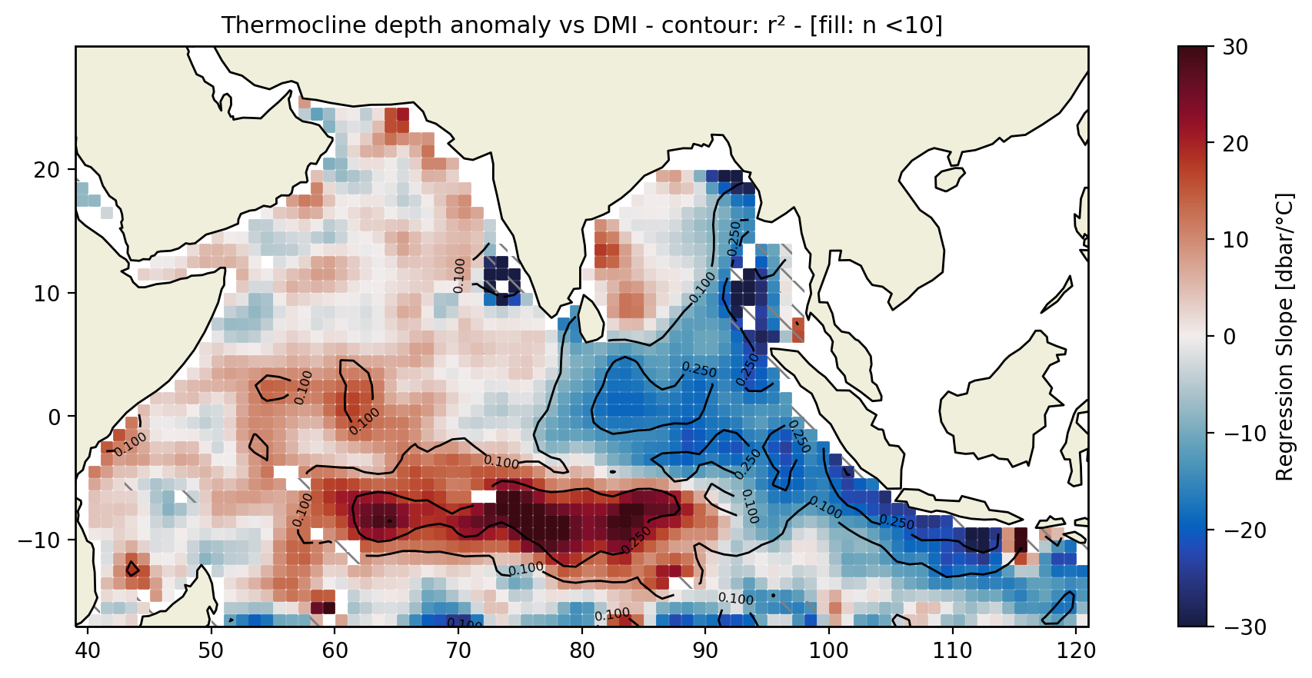
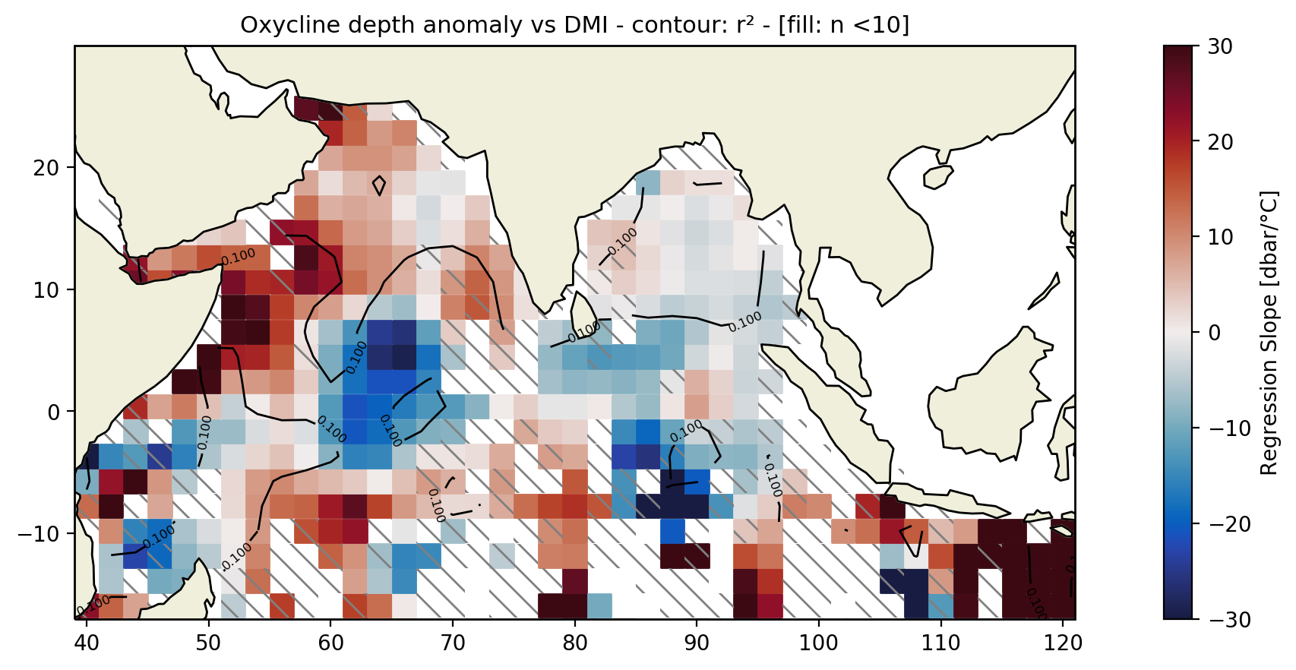
3). Corrélation de l’oxycline et de la thermocline avec le DMI
Slope of the regression line between the thermocline depth anomaly and the mean DMI between October and November of the current year for floats from October to December or of the previous year for floats from January to April (colour). From May onwards the signal loses coherence. The contours are the limits of the same correlation (0.1 and 0.25). The regression is calculated only if there are more than 10 profiles in a box, otherwise the boxe is hatched in grey
Slope of the regression line between the oxycline depth anomaly and the mean DMI between October and November of the current year for floats from October to December or of the previous year for floats from January to April (colour). From May onwards the signal loses coherence. The contours are the limits of the same correlation (0.1 and 0.25). The regression is calculated only if there are more than 10 profiles in a box, otherwise the boxe is hatched in grey

Slide 12
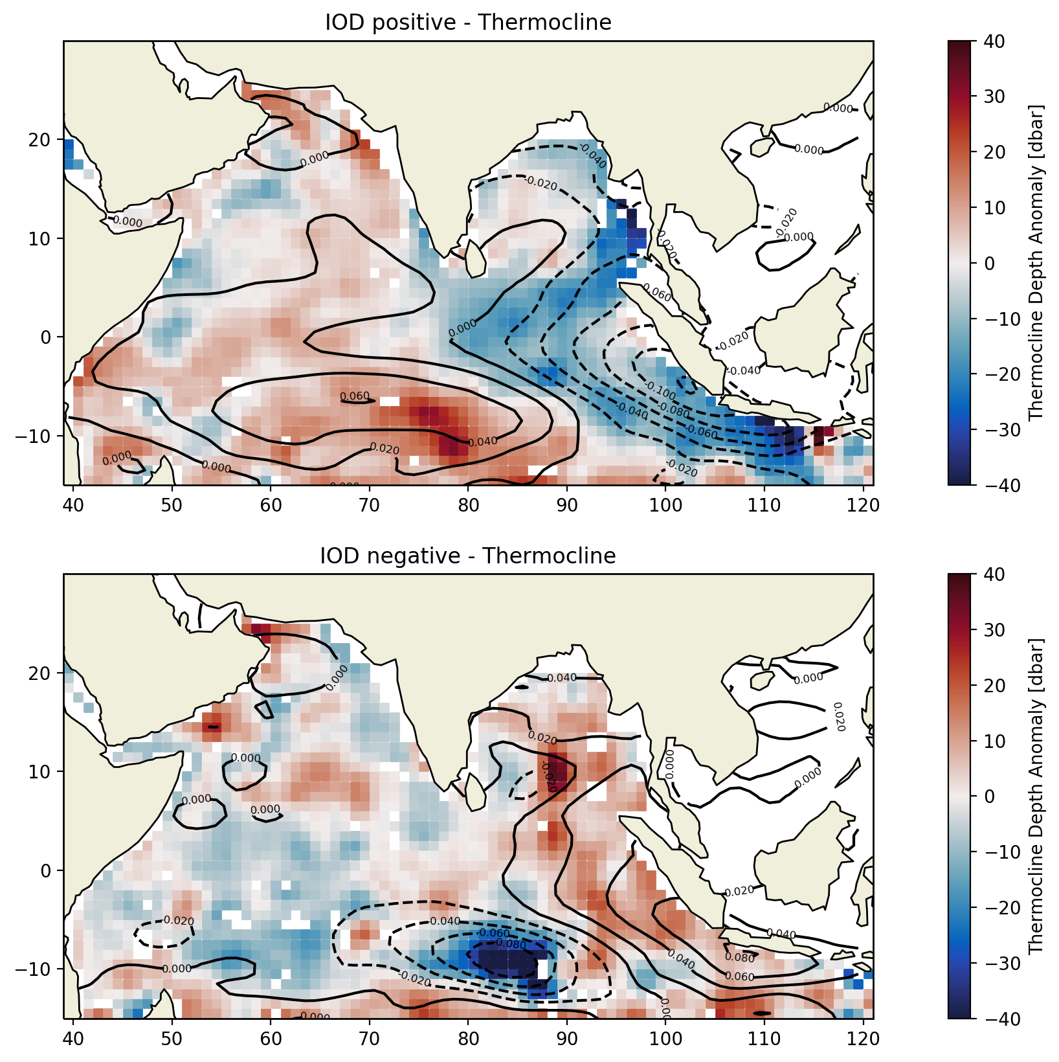
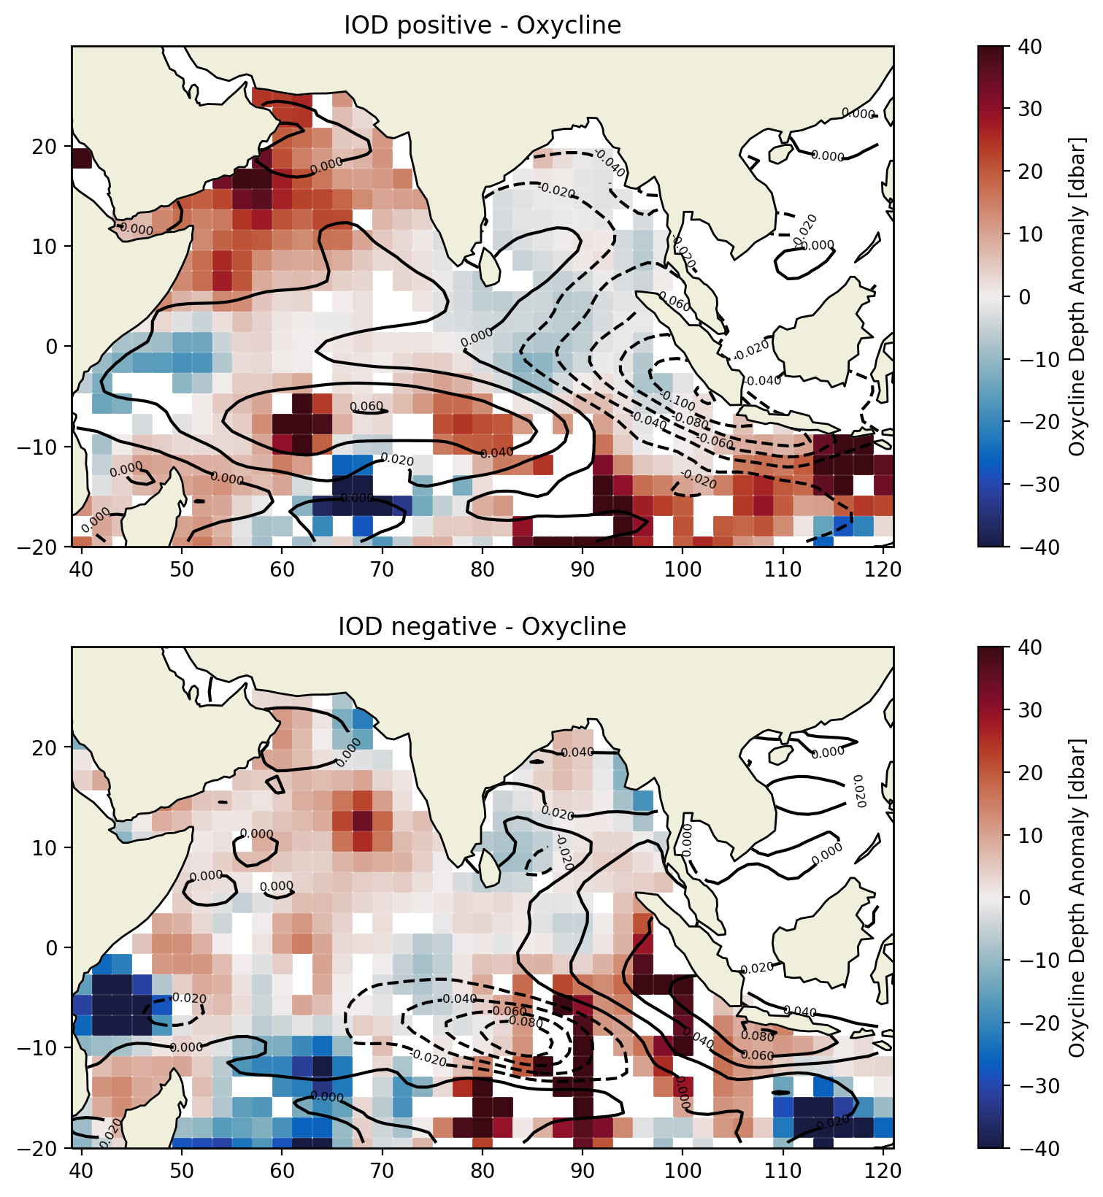
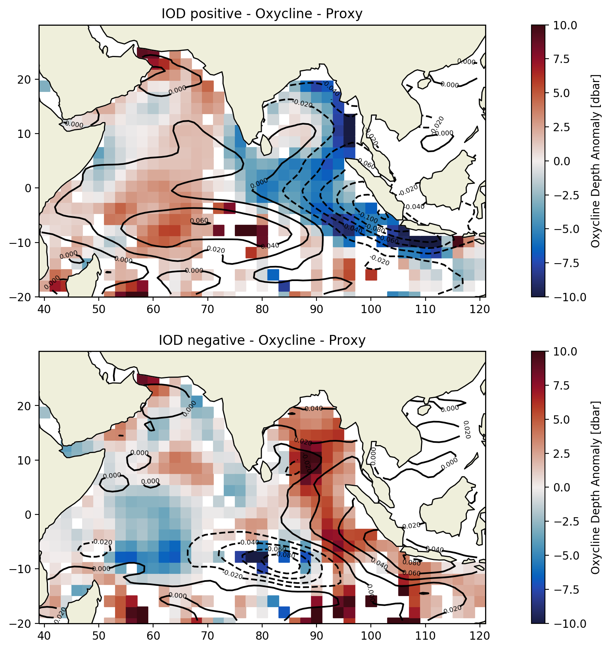
3). Composite de l’oxycline et de la thermocline pendant les deux phases de l’IOD
Composite of the thermocline anomaly during positive (DMI>std(DMI)) [a] and negative (DMI<-std(DMI)) [b] IOD phases (color). The contours correspond to the sea level anomaly composite (solid line: positive, dashed: negative).
Composite of the oxycline anomaly during positive (DMI>std(DMI)) [a] and negative (DMI<-std(DMI)) [b] IOD phases (color). The contours correspond to the sea level anomaly composite (solid line: positive, dashed: negative).
Composite of the oxycline anomaly during positive (DMI>std(DMI)) [a] and negative (DMI<-std(DMI)) [b] IOD phases (color). The contours correspond to the sea level anomaly composite (solid line: positive, dashed: negative). The oxycline anomaly is reconstructed using the thermocline anomaly and the interannual correlation between these two anomalies.

Slide 13
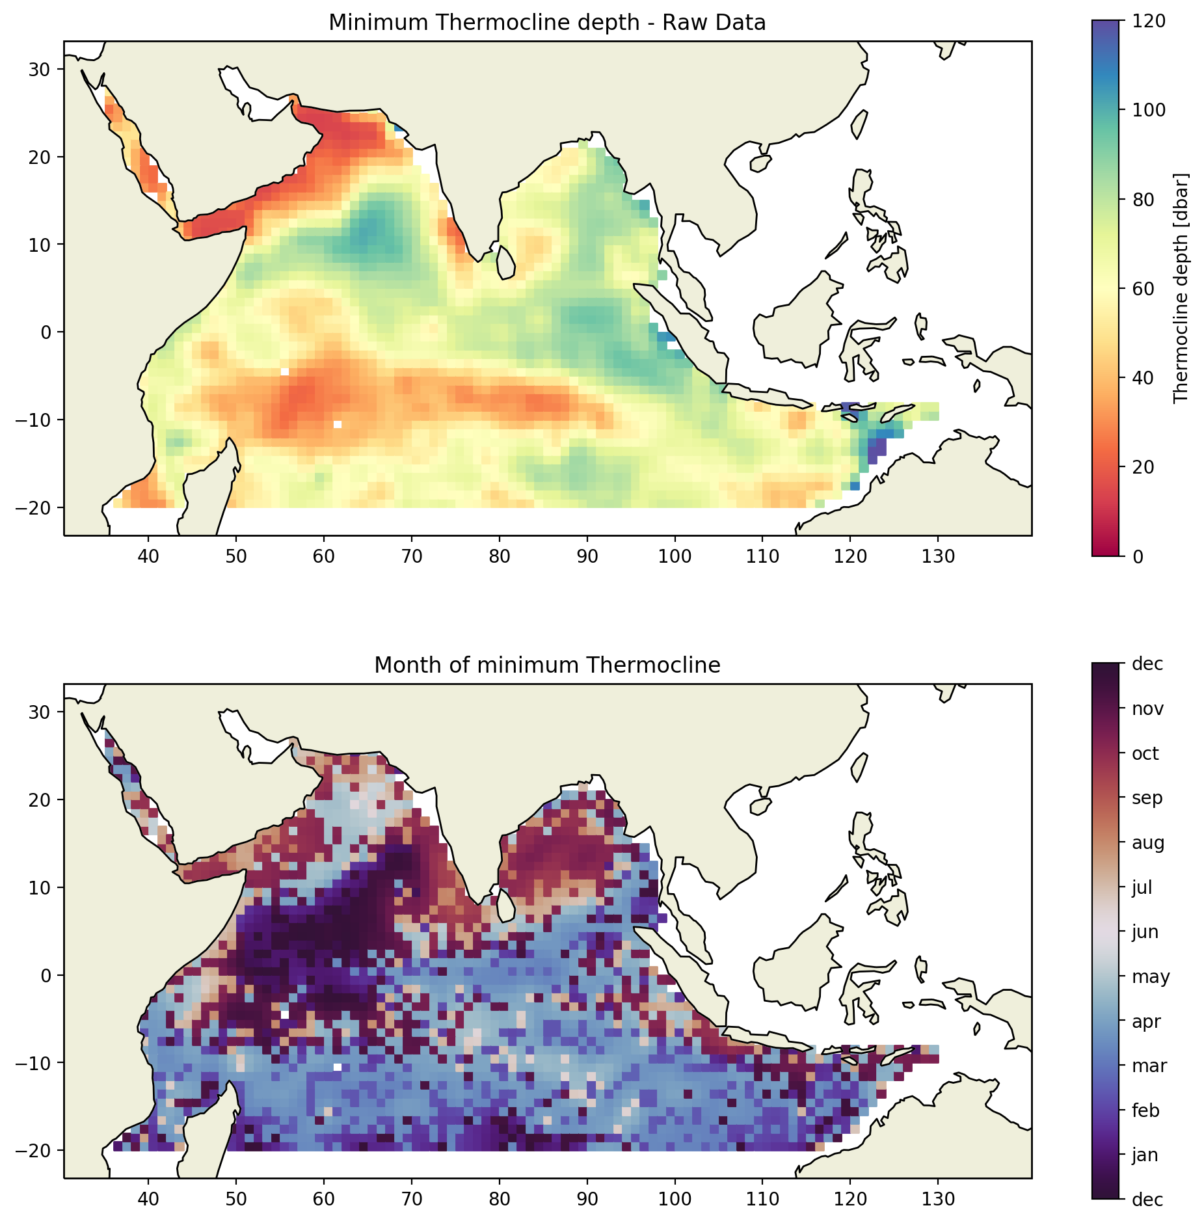
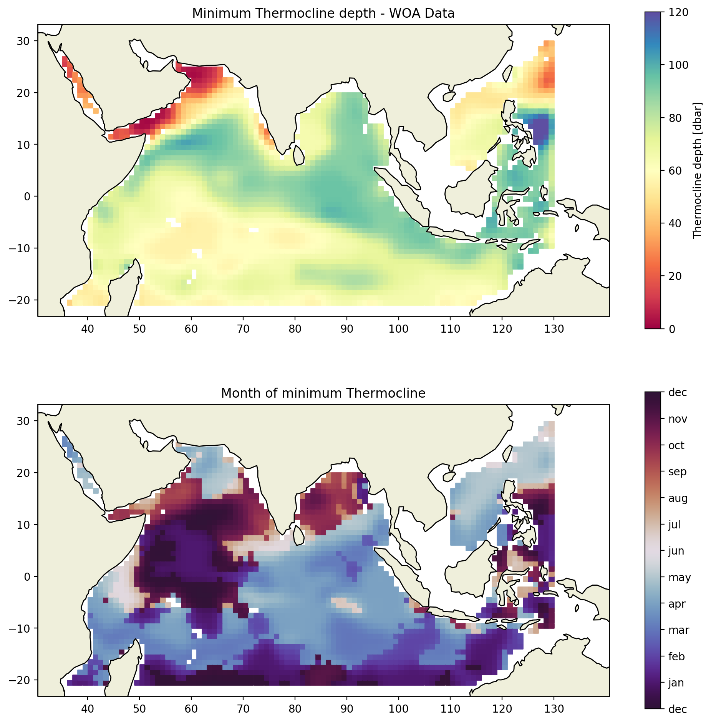
3). Mois de thermocline minimale
a)
b)
SI?
c)
d)
Monthly thermocline minimum depth composite, using raw data (a), world ocean atlas data (b). Maps of the months where the mean thermocline depth is minimum, using raw data (c), world ocean atlas data (d).

Slide 14
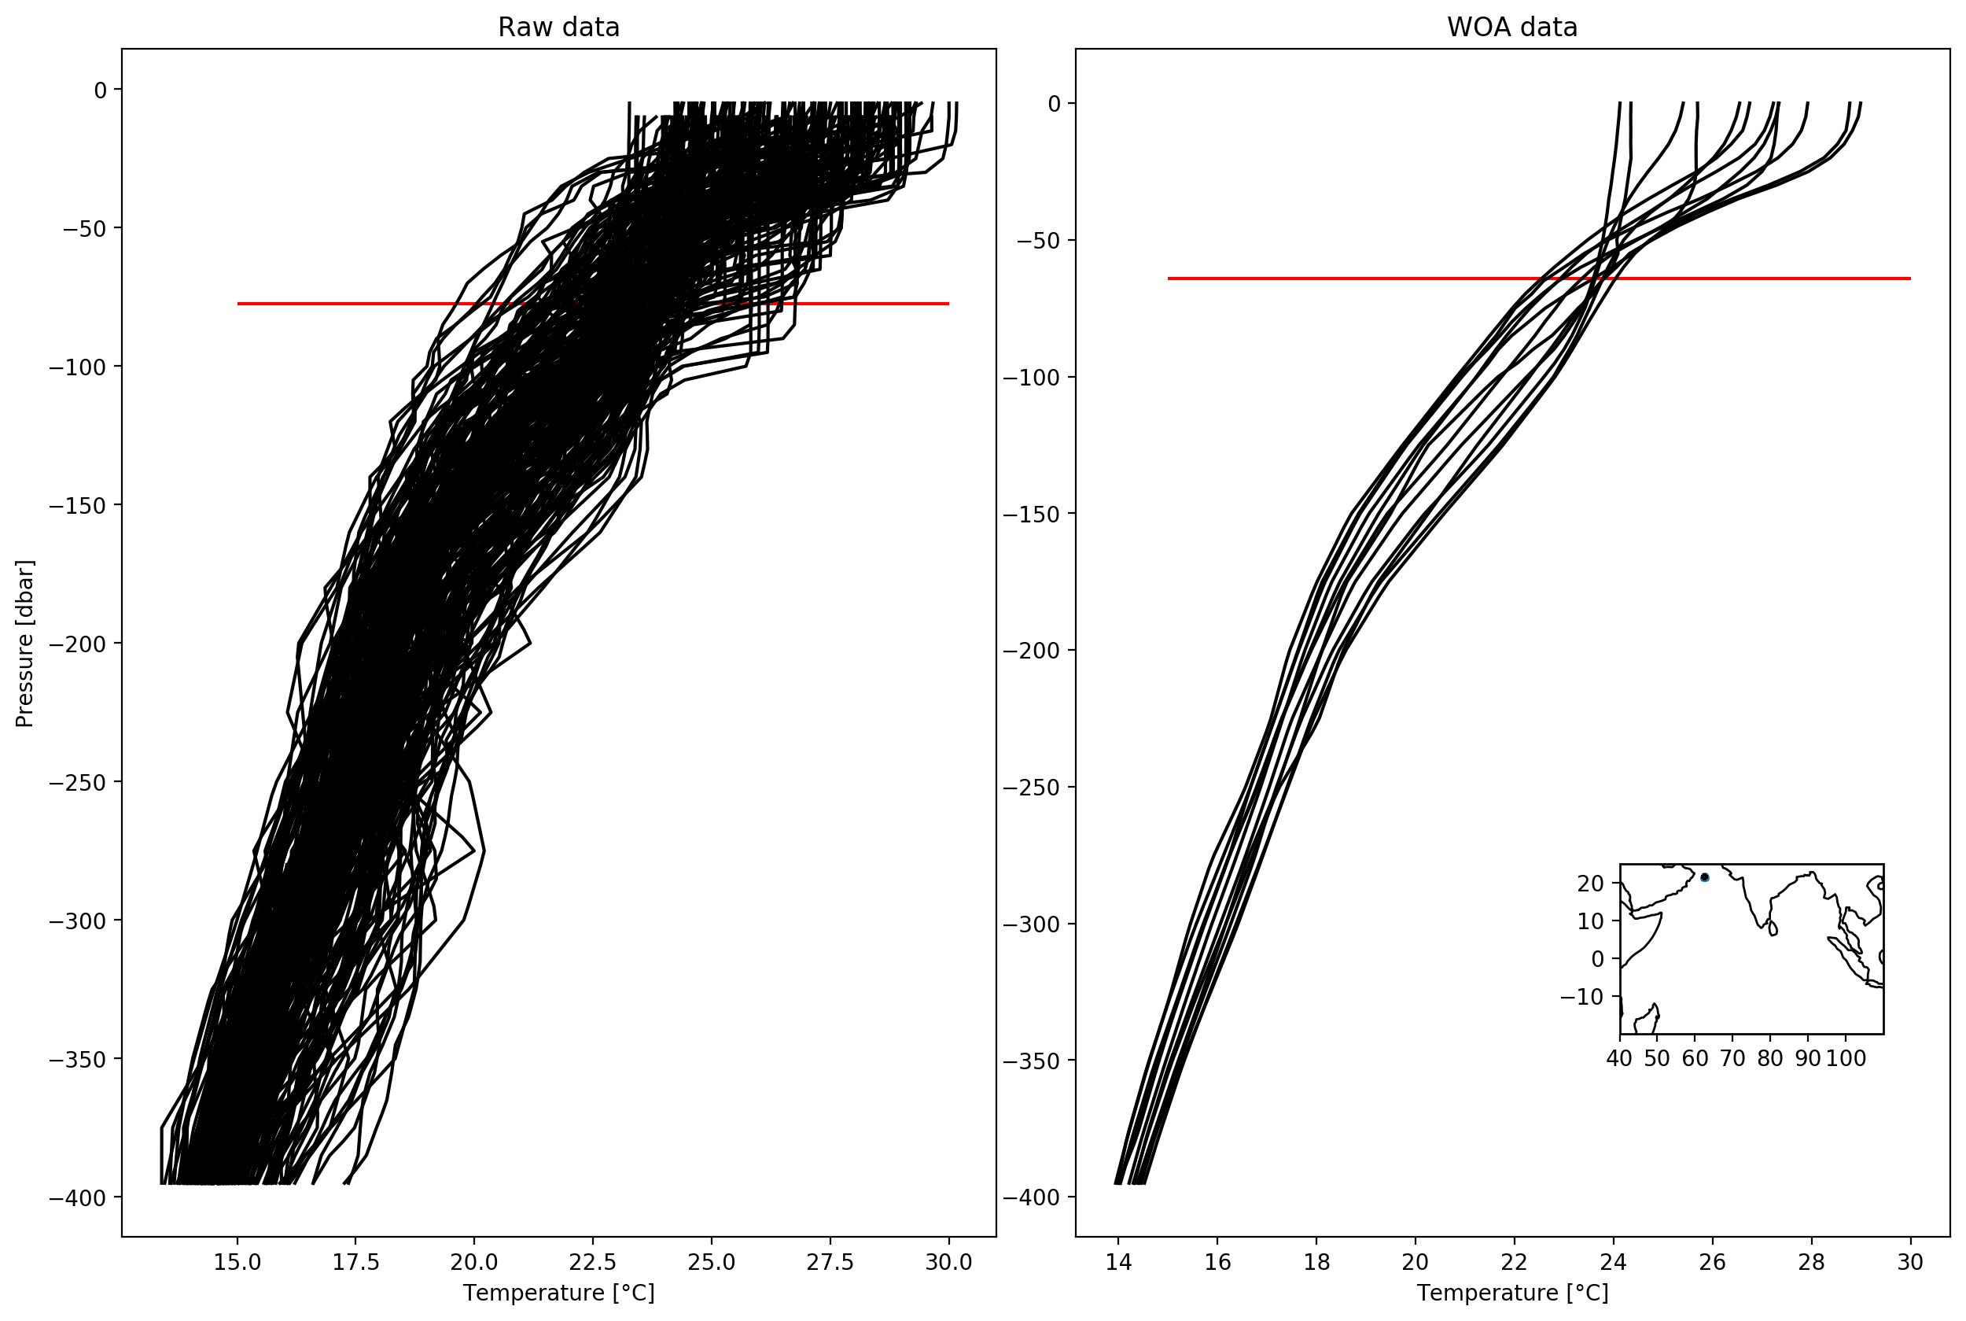
3). Mois de thermocline minimale
mettre ca dans la methodes.

Slide 15
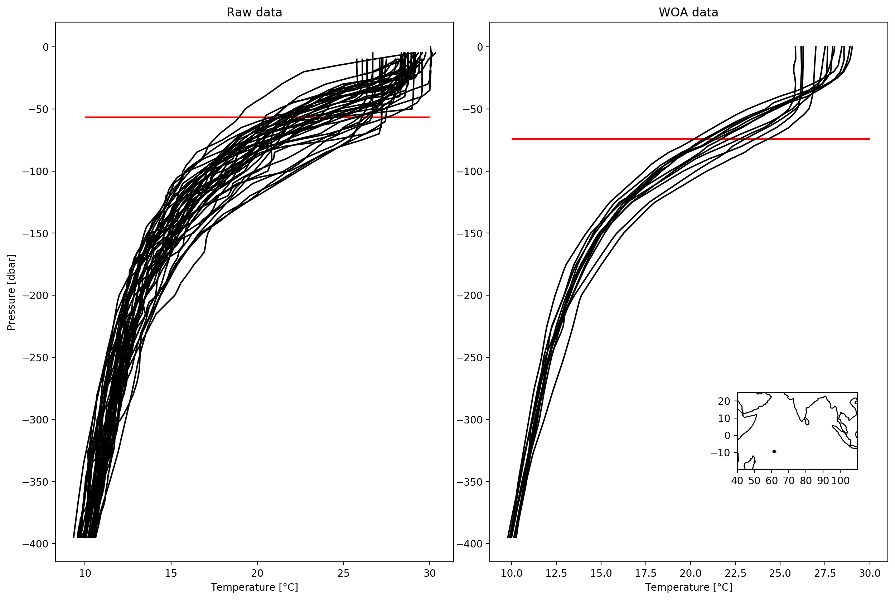
3). Mois de thermocline minimale

Slide 16
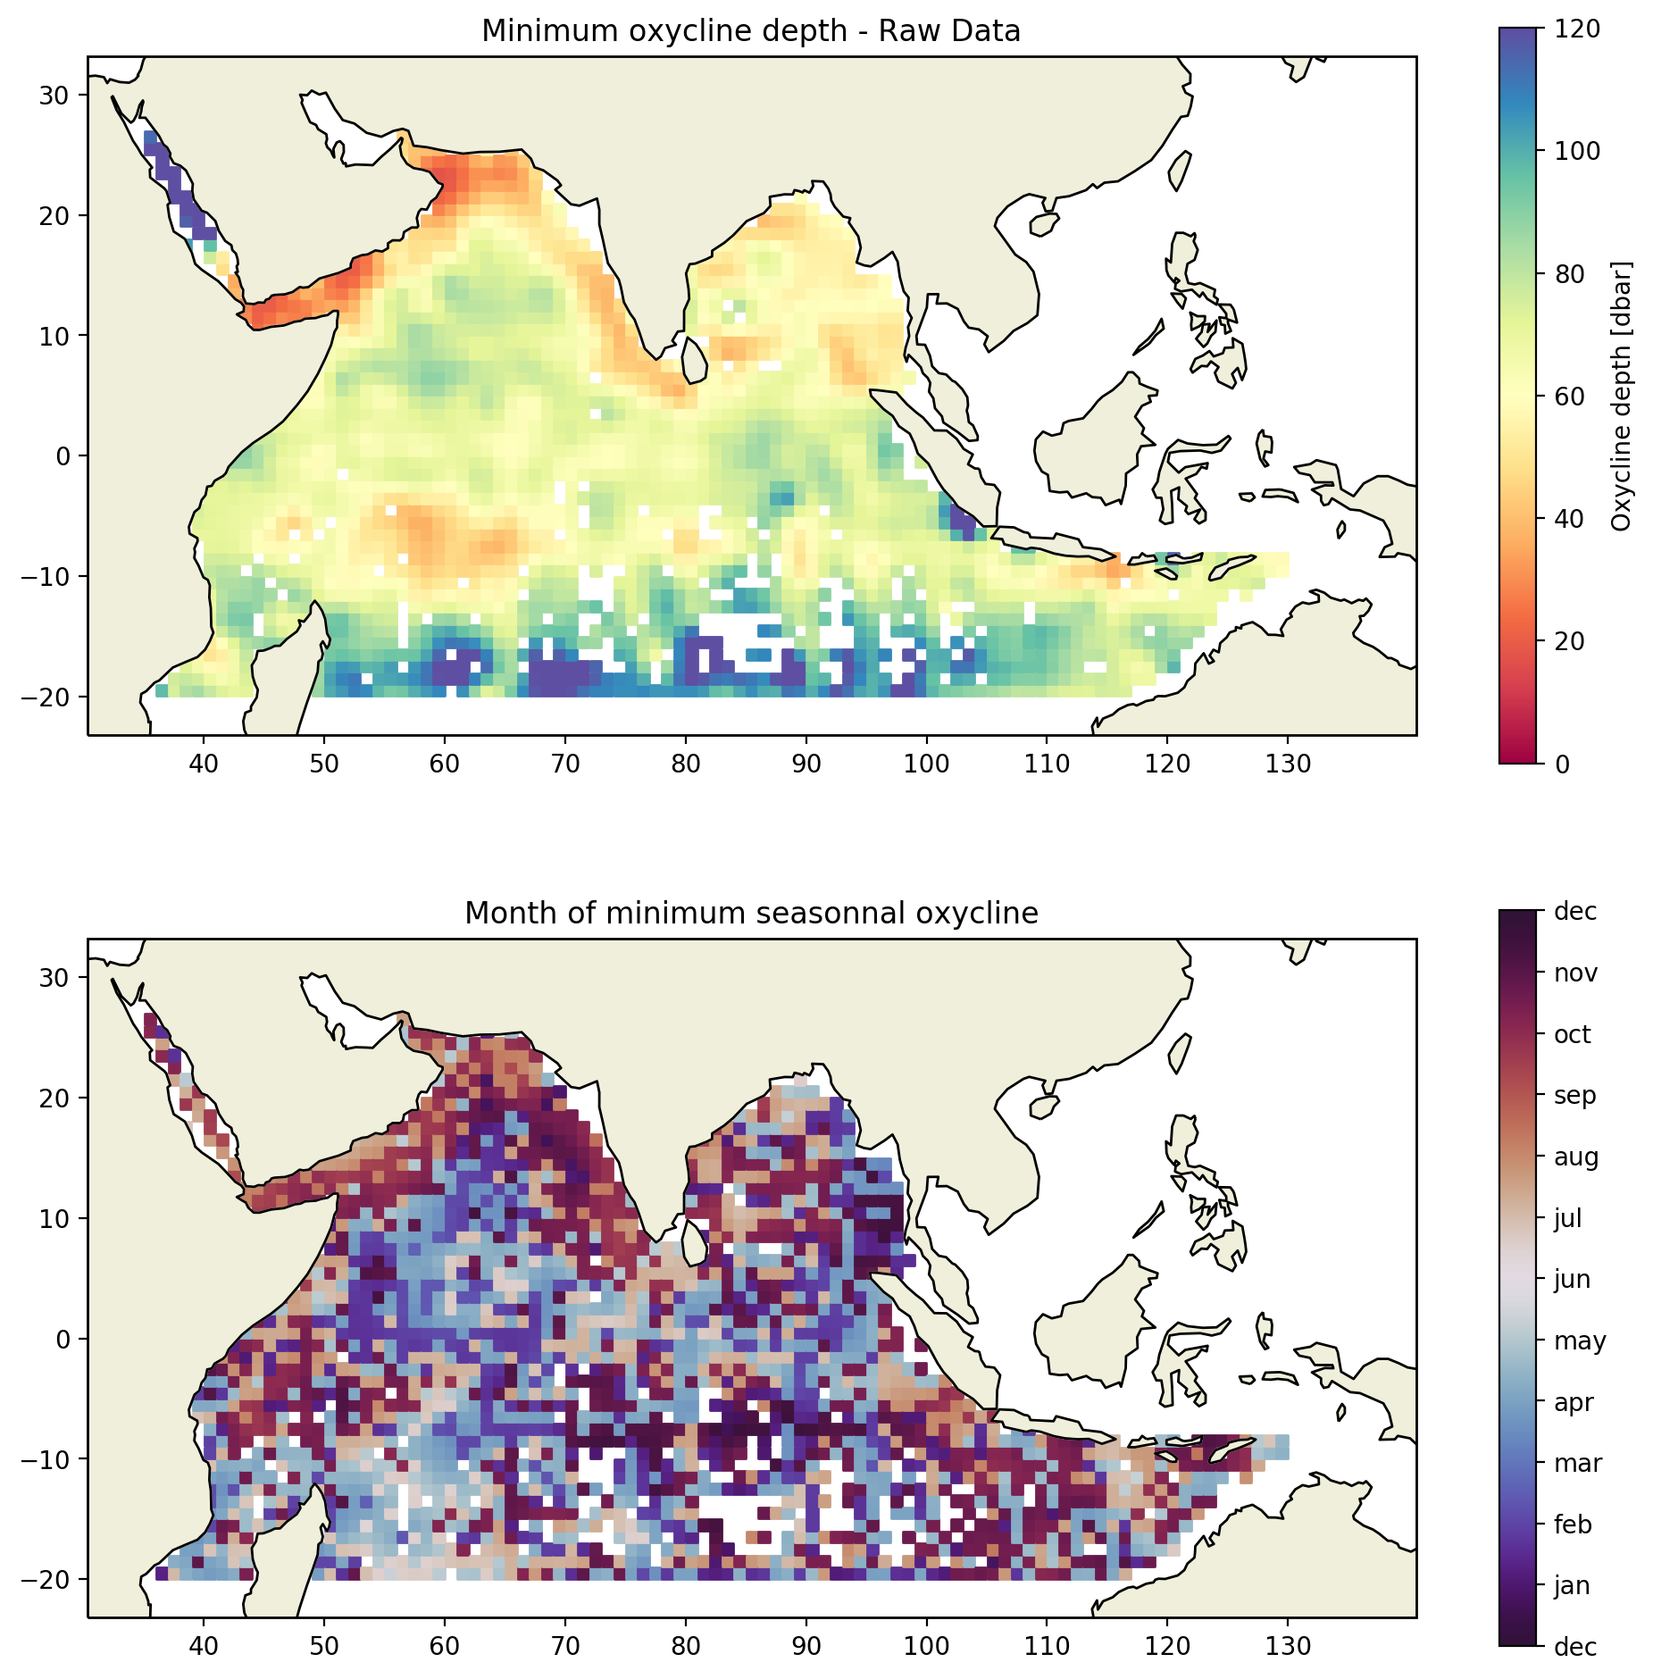
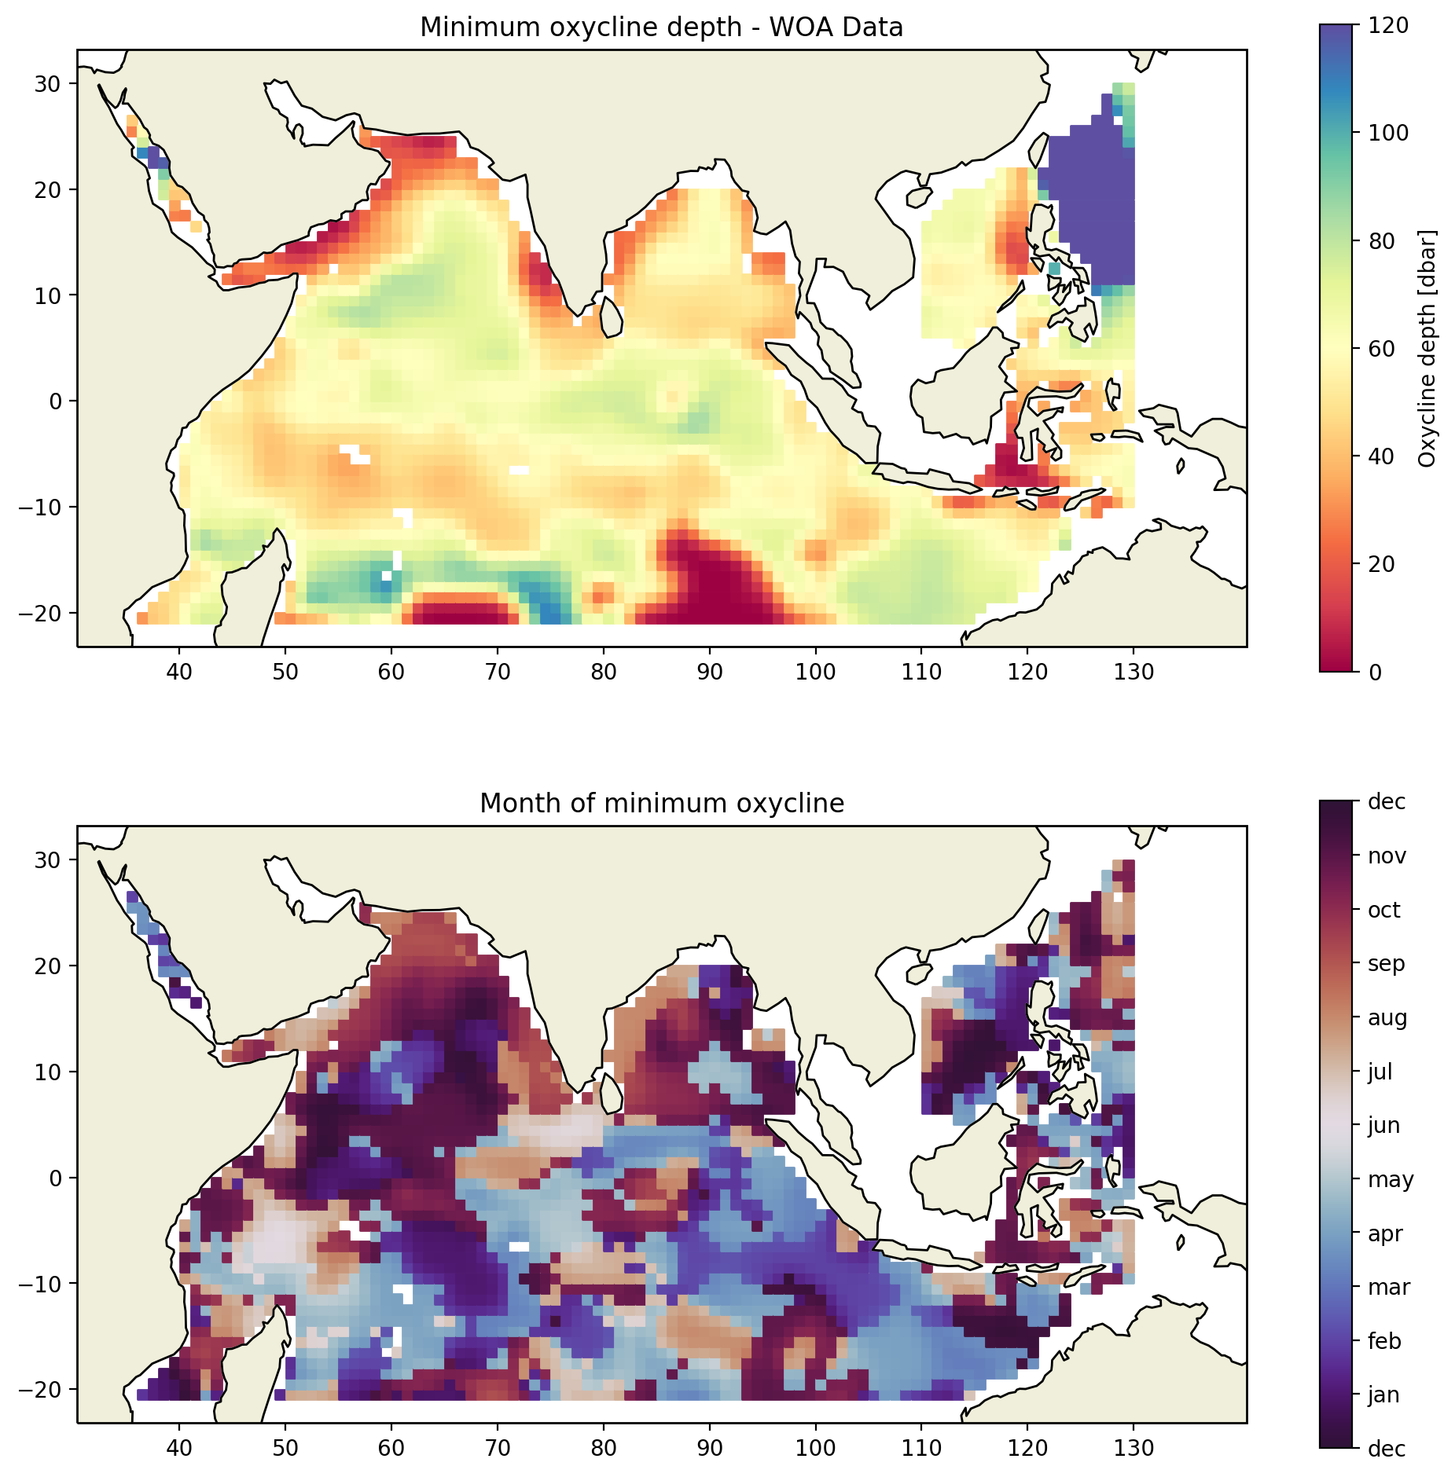
3). Mois d’oxycline minimale
a)
b)
c)
d)
Monthly oxycline minimum depth composite, using raw data (a), world ocean atlas data (b). Maps of the months where the mean oxycline depth is minimum, using raw data (c), world ocean atlas data (d).

Slide 17
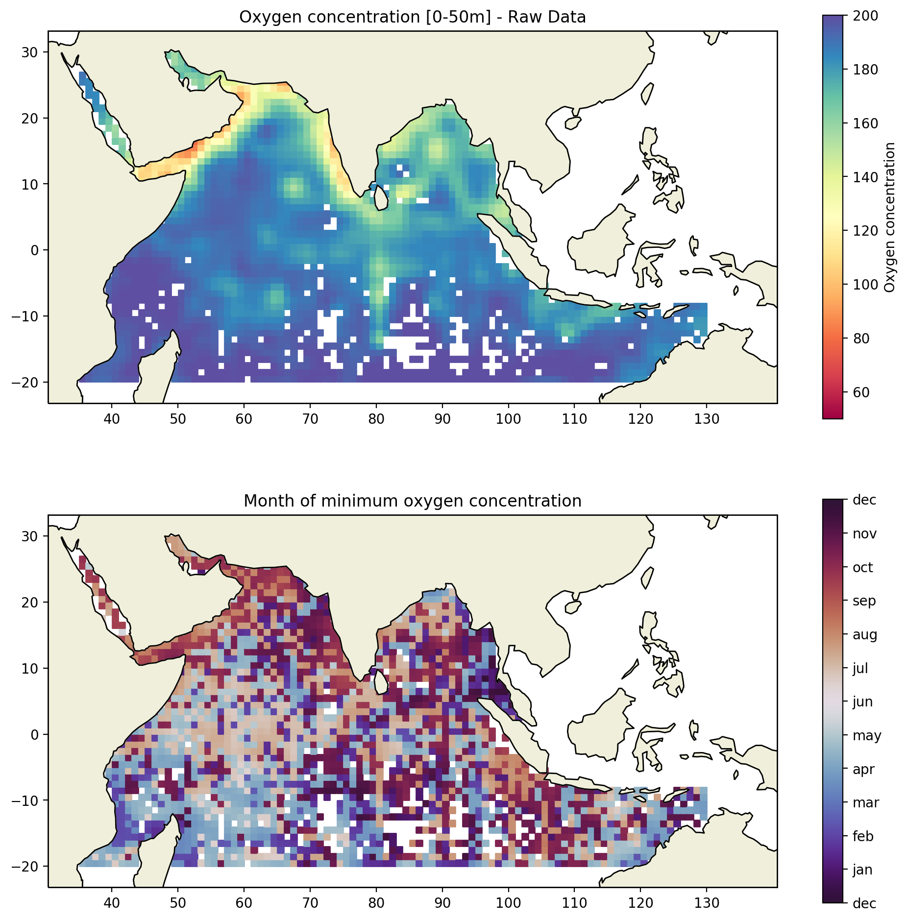
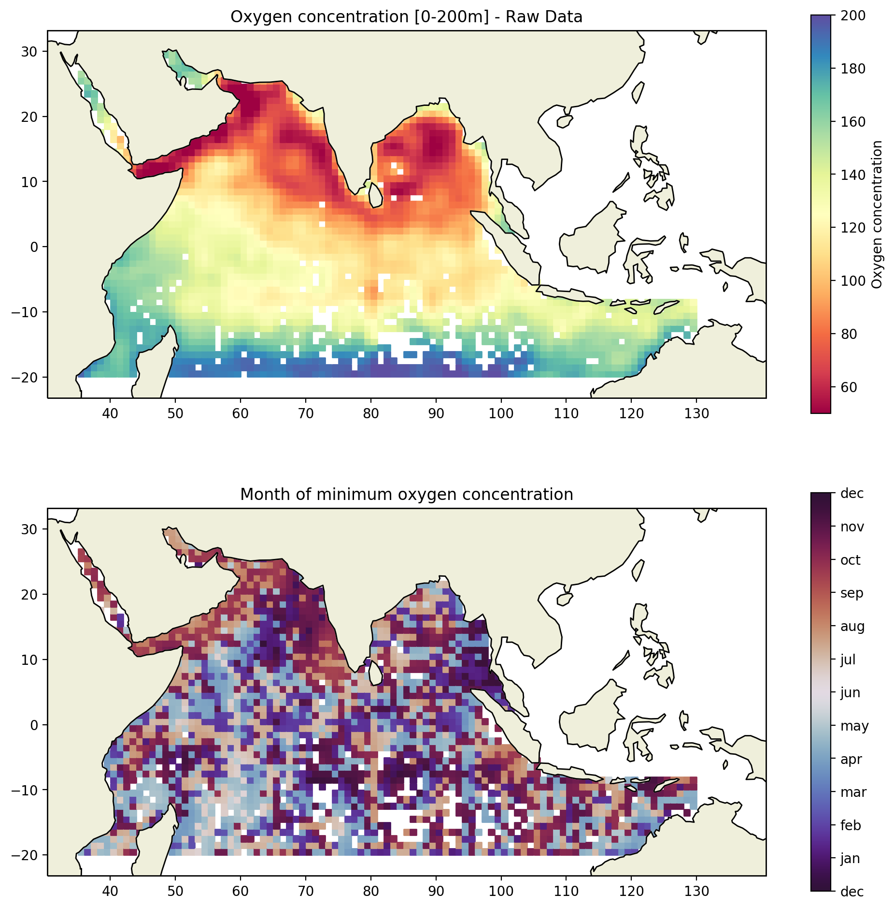
3). Oxygène intégré et oxygène intégré aux mois minimaux
a)
b)
c)
d)
Monthly minimum oxygen concentration composite, between 0 and 50m (a) between 0 and 200m (b), using raw data. Maps of the months where the mean oxygen concentration is minimum, between 0 and 50m (c), between 0 and 200m (d).

Slide 18
below move to SI or method?

Slide 19
I
IOD and thermocline / oxycline variability

Slide 24
II
coastal dead zones, hypoxia (60 uM), Breitburg et al 2018, Vaquer-Sunyer and Duarte 2008
conditions conducive to low oxygen on the shelf seasonally, IOD reinforces or dampen the seasonal effect

Slide 25
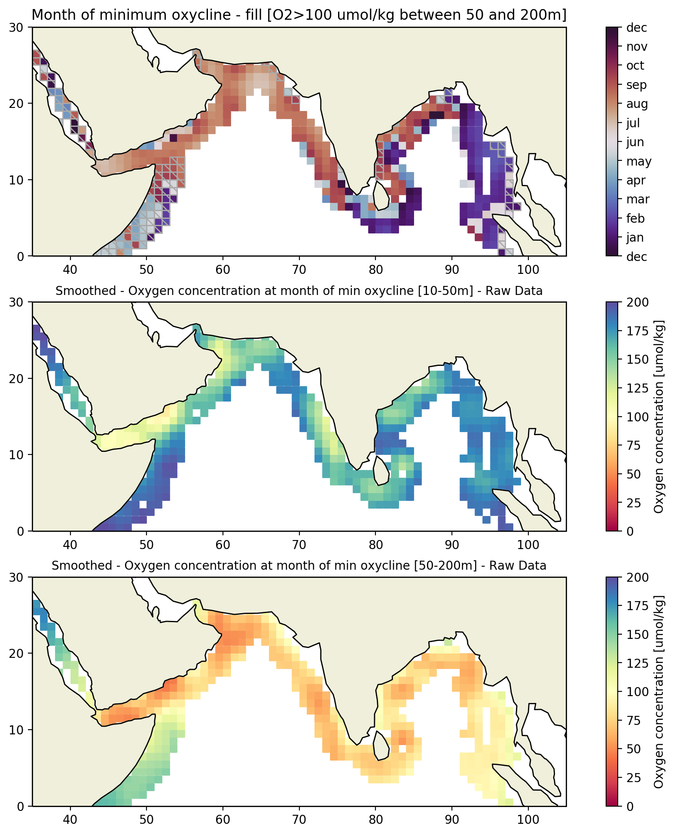
4). Month of minimum oxycline
a)
summer/fall AS and western BoB
winter/spring in eastern Bob
b)
Month of seasonal shallowest oxycline on coastal shelf. Grey hatching indicates areas with high oxygen concentrations not favorable for dead zones (mean O2 between 50 and 200m > 100 umol/kg).
Mean oxygen concentration between 10 and 50 m (b), 50 and 200 m (c) during the months when oxycline is shallowest
method: smoothed using a gaussian filter, the (a) smoothed using a gaussian filter
c)

Slide 26
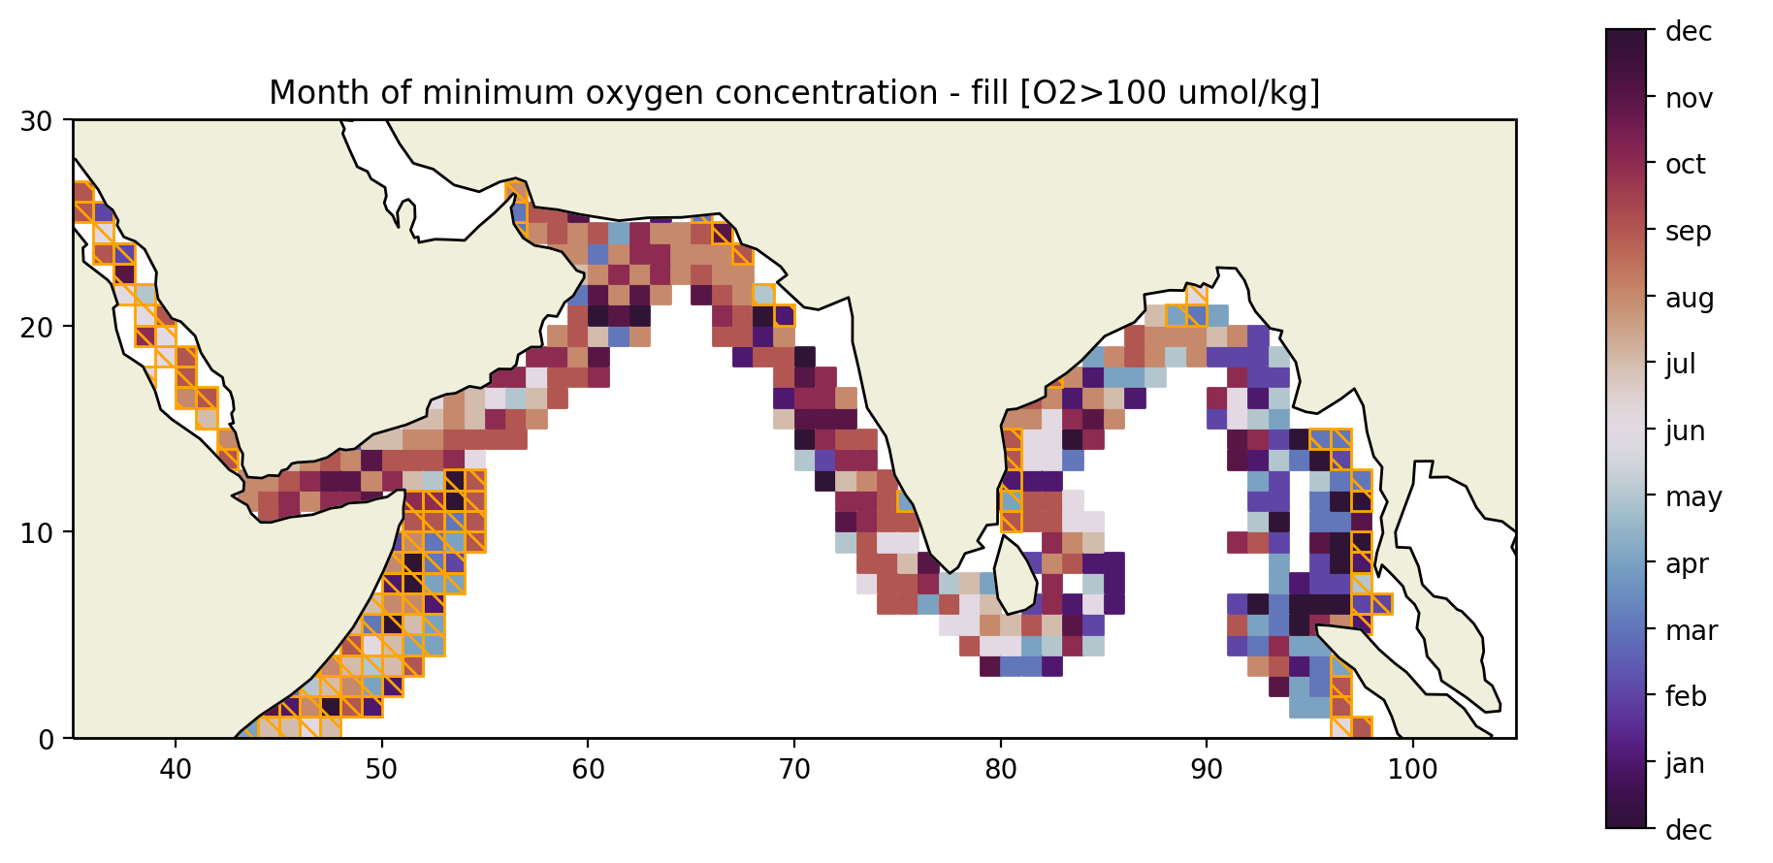
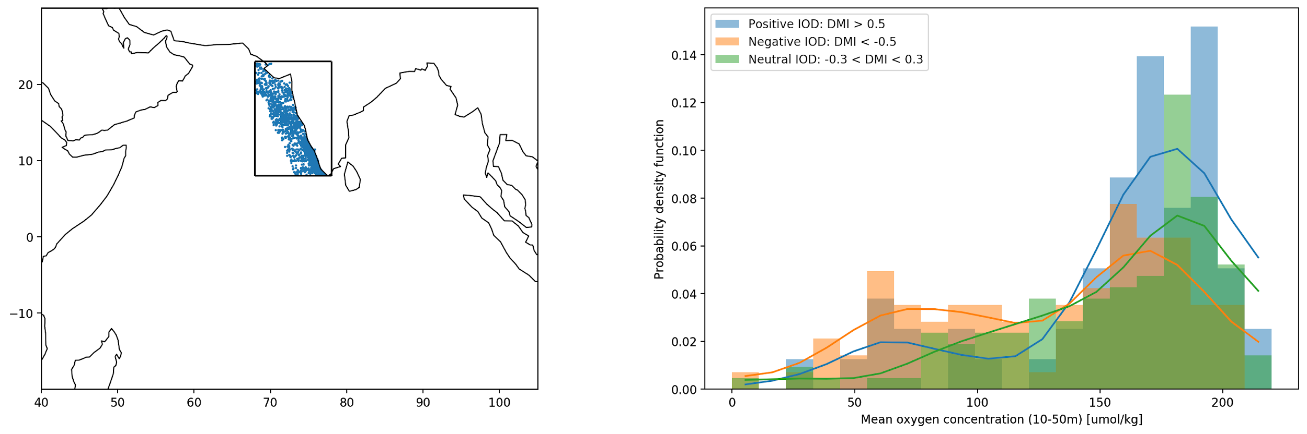
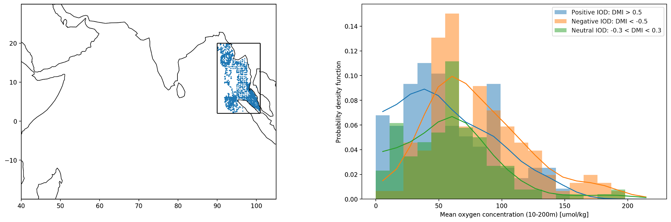
4). Oxygène dissous intégré vs DMI
1
2
Study area: 90-101°E 2-20°N (a) Probability density function of the profiles as a function of the mean oxygen concentration between 10 and 200m during a positive (blue), negative (orange) or neutral (green) IOD phase. The solid lines correspond to a Gaussian approximation of the distribution of the profiles.

Slide 27
1
2

